Slide 1
STAND UP PLACER
Human Trafficking
Presented By:
Vickie Turnquist
Human Trafficking Services Coordinator

Slide 2
Stand Up Placer Services
Emergency Services
Supportive Services
24/7 Confidential Crisis Line
1-800-575-5352
90-day Emergency Safe House
24/7 Accompaniment Services
Access to Emergency:
Food and Clothing
Hotel Vouchers
Transportation
Individual Therapy
Group Therapy and Support Groups
Legal Advocacy services
Supportive housing programs
Assistance signing up for Medi-Cal, CalFresh, WIC, CalWORKs
Outreach and Prevention programming
Comprehensive Advocacy

Slide 3
Additional Services provided by the HT Advocacy Team at SUP:
HT Support Group
7-week therapeutic group class
-Focuses on many topics surrounding healing from trauma
*Tattoo Removal

Slide 4
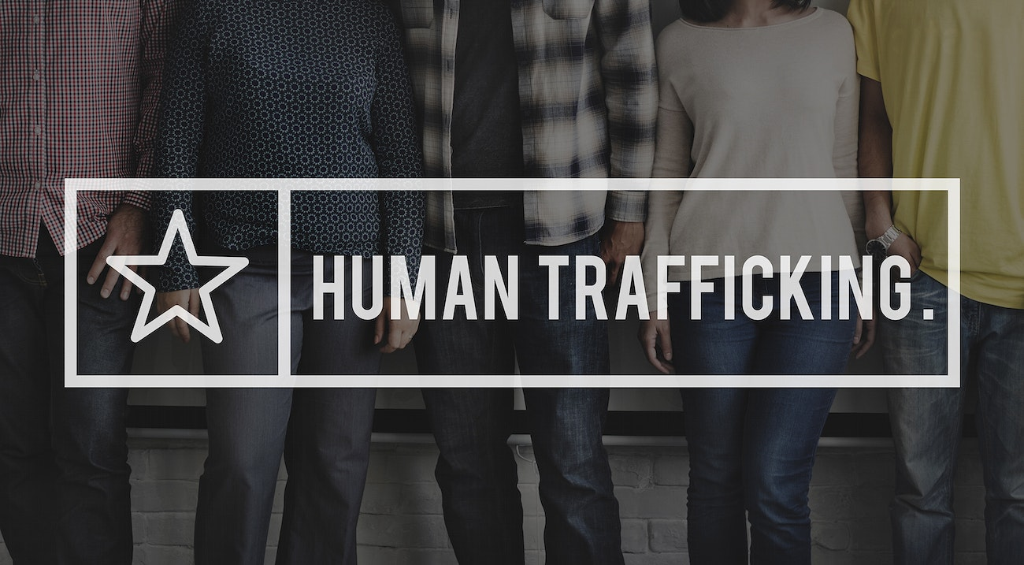
What is
Human Trafficking?

Slide 5
Human trafficking is a crime involving the exploitation of someone for forced labor or a commercial sex act using force, fraud, or coercion.
Human trafficking affects individuals across the world, including here in the United States, and is commonly regarded as one of the most pressing human rights issues of our time.
Human trafficking affects every community in the United States across age, gender, ethnicity, and socio-economic backgrounds.

Slide 6
The History of Human Trafficking
The timeline of human trafficking is long. For as long as humans have existed, human trafficking has existed.
Throughout history, it has consistently involved the exploitation of vulnerable people for profit through force, fraud, or coercion, adapting its methods to the social and economic landscapes of different eras
Human trafficking is commonly referred to as “modern-day slavery.” While the words slavery and human trafficking are frequently used interchangeably, “slavery” has a more general definition. Merriam-Webster.com defines slavery simply as “the state of a person who is held in forced servitude.”
The United Nations Office on Drugs and Crime (UNODC) defines human trafficking as the act of gathering, moving, receiving, or keeping human beings by threat, force, coercion, or deception, for exploitative purposes

Slide 7
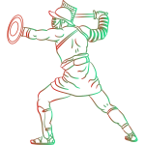
Ancient and Pre-Modern
For much of human history, slavery was legal, regulated, and widely practiced across the world. Ancient civilizations such as Rome, Greece, and Egypt depended heavily on enslaved people for agricultural labor, domestic service, and entertainment, including gladiatorial combat. Enslaved individuals were often war captives or people forced into servitude because of debt. Before European colonization, various forms of slavery existed across Africa, Asia, and the Americas. These systems differed by region but were commonly tied to debt bondage, social hierarchy, or armed conflict.

Slide 8
The Transatlantic Slave Trade (1500-1866)
Legalized Trafficking: European powers established a large‑scale, highly organized system of legally sanctioned trafficking of enslaved African people. This transatlantic trade forcibly displaced an estimated 12.5 million individuals over the course of roughly 350 years, primarily to the Americas. End of Legal Slavery: During the 19th century, abolitionist movements drove a gradual shift in law that led to the banning of the slave trade and, eventually, slavery itself. Britain outlawed the trade in 1807, and the United States formally abolished slavery with the ratification of the 13th Amendment in 1865.
Notes:
Aprox 112.5 million individuals over 350 years were brought to the Americas during the Transatlantic Slave Trade. The 19th century saw the rise in abolitionist movements which led to outlawing slavery. Great Britian outlawed the practice first in 1807 and then it was outlawed in America in 1865 after the end of the Civil War.

Slide 9
Shift To White Slavery (late 19th-early 20th century)
Criminalization: Although formal slavery was abolished, systems of exploitation persisted by shifting underground. In the late nineteenth and early twentieth centuries, public attention centered on the issue of so‑called “white slavery,” a term used at the time to describe the coercion of European women into forced prostitution. International Conventions: One of the earliest international efforts to address human trafficking was the 1910 International Convention for the Suppression of the White Slave Trade. Over time, international legal frameworks broadened their scope to recognize and address the trafficking of women and children regardless of race. 20th‑Century Evolution: Throughout the twentieth century, traffickers adapted to new legal restrictions by targeting migrant women and children, relying on forged documents, deceptive recruitment practices, and systems of debt bondage to maintain control.

Slide 10
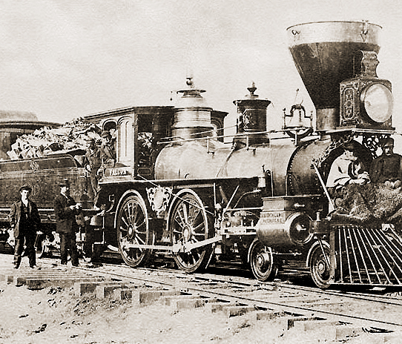
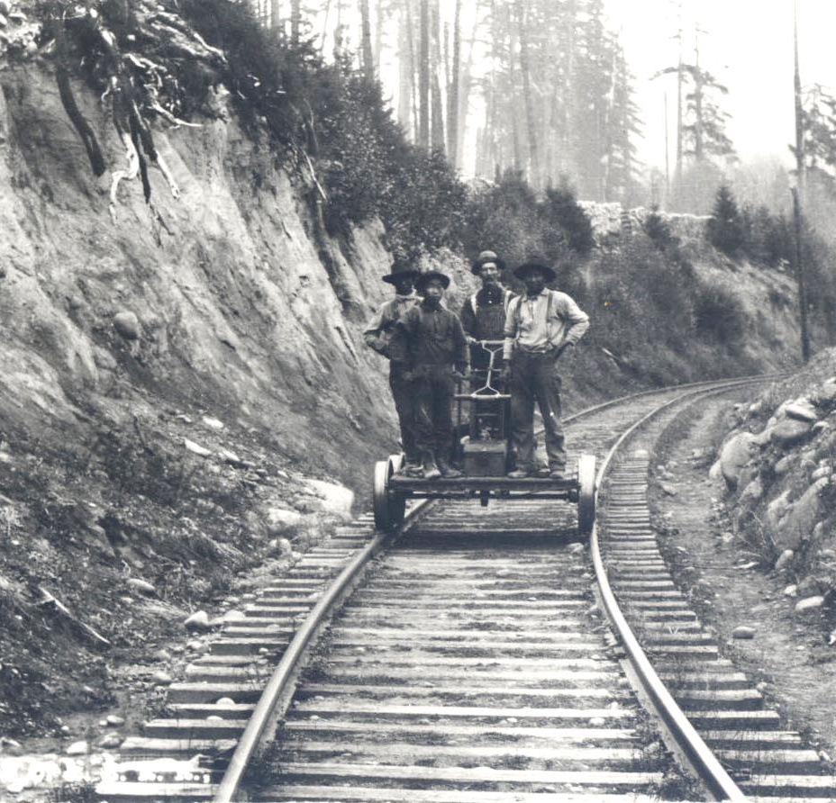
California’s Trafficking History
Trafficking of Chinese Immigrants into the United States (19th Century)
The primary reason for the mass migration of Chinese people to the United States was the California Gold Rush of 1848.
The allure of wealth and the demand for labor in gold mines, as well as later in the construction of the Transcontinental Railroad, attracted thousands of Chinese laborers.
A significant number of Chinese immigrants were trafficked to work on the Transcontinental Railroad under false promises and coercive contracts.
Parallel to labor trafficking, there was a disturbing trend of trafficking Chinese women for sexual exploitation. Many of these women were deceived or coerced into leaving China and were sold into prostitution in the burgeoning Chinatowns of American cities.
These women lived in appalling conditions, trapped in a cycle of abuse and control by traffickers and brothel owners. The societal stigma and legal constraints of the time left them with little recourse for escape or justice
This Photo by Unknown Author is licensed under CC BY-NC-ND
This Photo by Unknown Author is licensed under CC BY

Slide 11

Modern Day Trafficking (2000-Present)
Trafficking Victims Protection Act (TVPA) of 2000: Established comprehensive federal definitions and penalties for sex and labor trafficking. It also created victim protections and prevention strategies.
Human trafficking is reported in all 50 states, with hotspots in California, Texas, and Georgia. Victims include U.S. citizens and foreign nationals, often from Mexico and Central America
Human trafficking did not end; it has adapted and changed from an openly legalized system to an underground criminal industry that remains one of the most pressing human rights issues today.

Slide 12
Human Trafficking vs. Human Smuggling
Trafficking
Smuggling
Using physical or psychological means to hold another person in servitude against their will
Not a crime of movement (i.e., crossing borders)
No consent and indefinite
Facilitating, transporting, or attempting to transport someone across a border illegally
Often done with consent
Ends when a border has been crossed and a fee has been paid

Slide 13
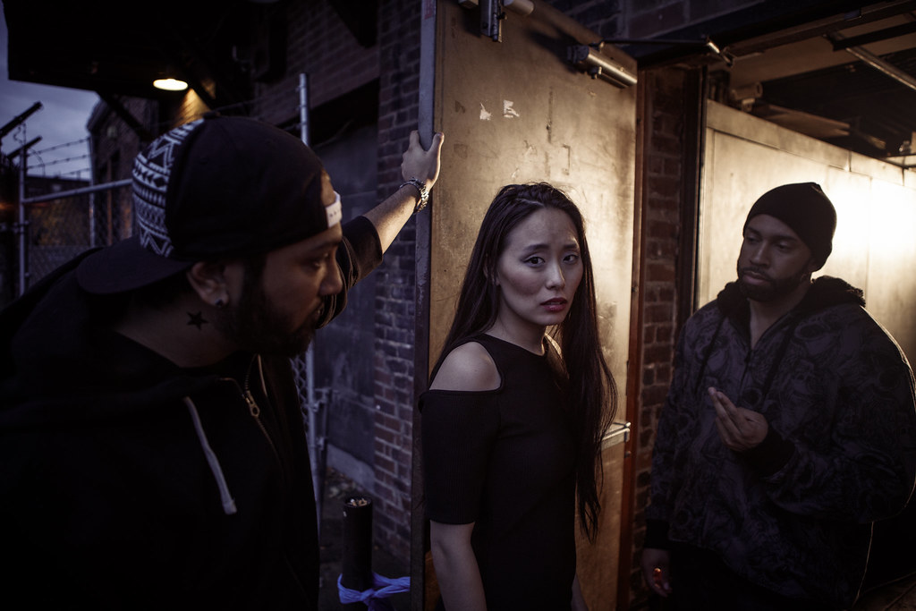
Myths vs. Realities
Human trafficking is always or usually a violent crime.
  The most popular myth about human trafficking is that it often involves kidnapping or physically forcing someone into a situation.
  Most traffickers use psychological means such as, tricking, defrauding, manipulating or threatening victims into providing commercial sex or exploitative labor.
This Photo by Unknown Author is licensed under CC BY-NC

Slide 14
Myths vs. Realities
Traffickers target victims they don’t know.
Many survivors have been trafficked by romantic partners, including spouses, and by family members, including parents.
Only women and girls can be victims and survivors of sex trafficking.
Men and boys are also victimized by sex traffickers. LGBTQ boys and young men are seen as particularly vulnerable to trafficking

Slide 15
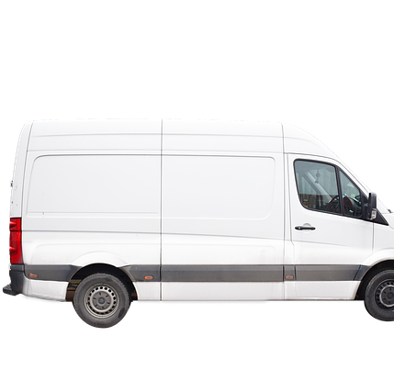
Rumors vs. Realities
Rumor: White passenger vans or commercial vans with external locks are a sign of trafficking. If you see these vehicles, you should be suspicious.
Reality: Traffickers drive all kinds of vehicles. There is no evidence that they favor white vans or that law enforcement has information on specific trafficking cases in which the use of white vans was integral to the crime.
Commercial vans typically don’t have a lot of windows and may be used to store expensive equipment for a business, which explains the presence of locks and bars over windows – to prevent theft.

Slide 16
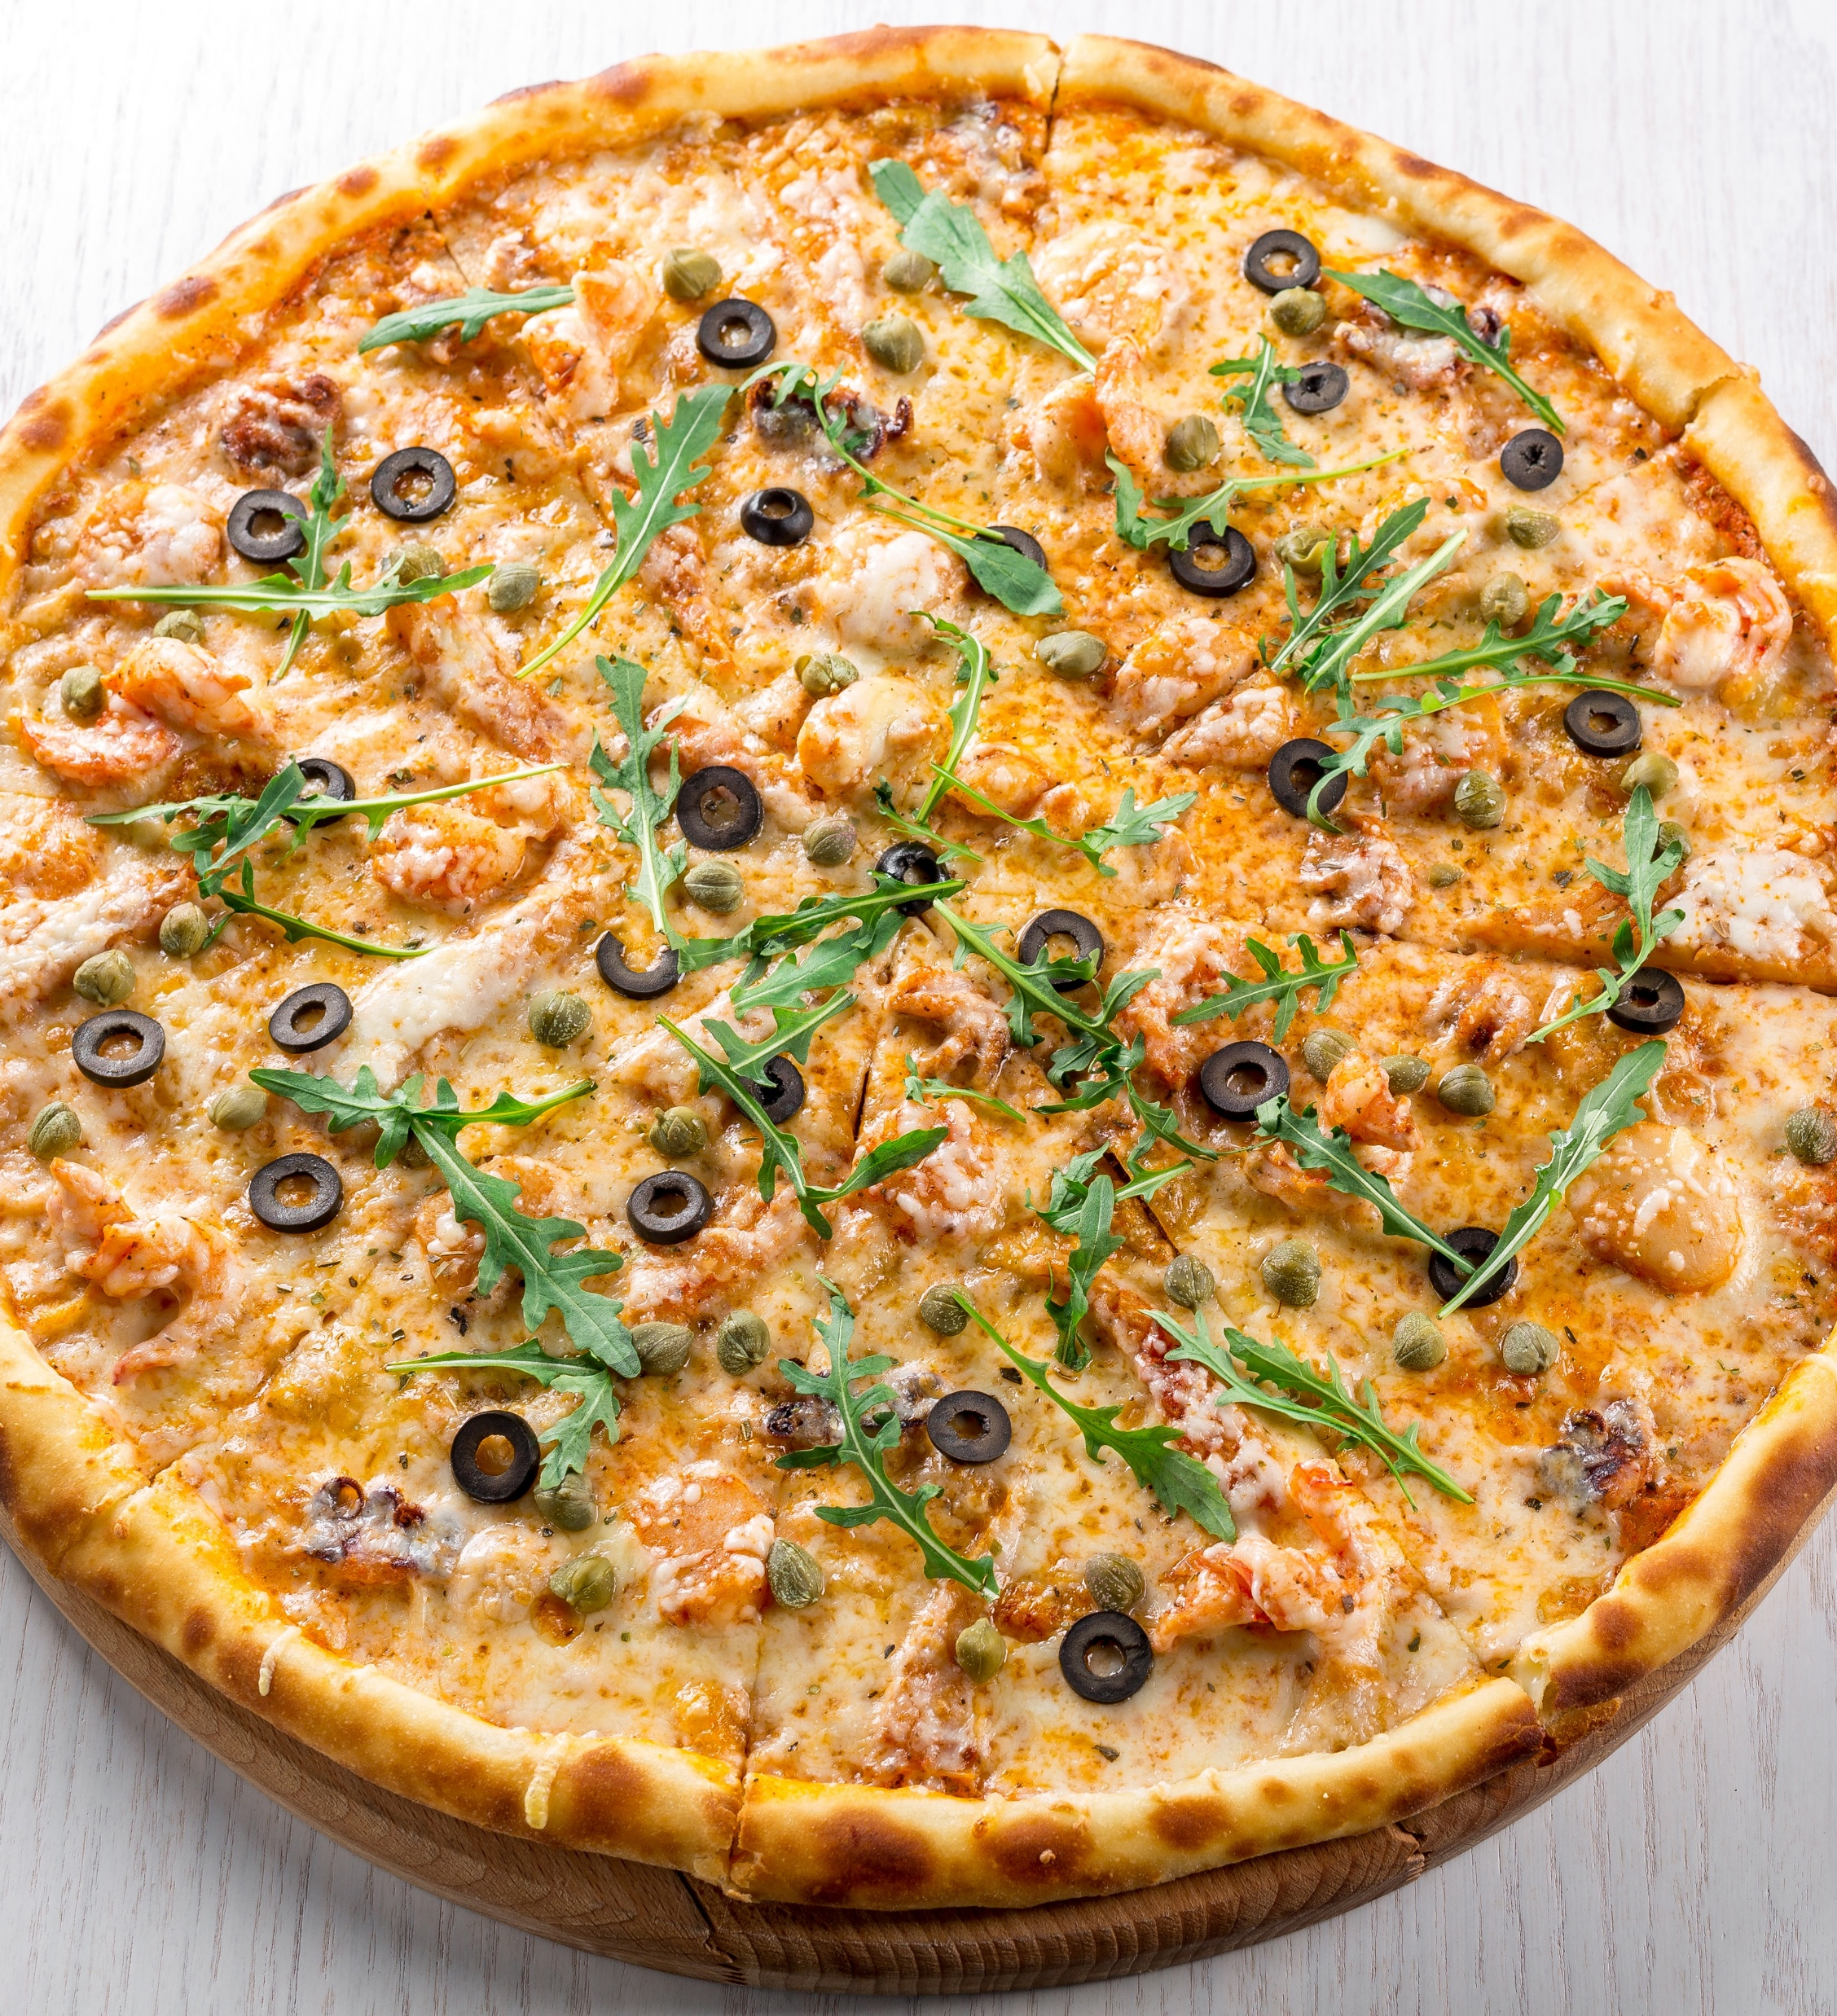

Rumors vs. Realities
Rumor: Traffickers and pedophiles communicate in code, referring to boys for sale as “hotdogs” and girls as “pizza.” T-shirts sold by major retailers with slogans like “Want a pizza me” are part of this conspiracy.
Reality: Cheese pizza is a code term sometimes used among people who distribute and share child sexual abuse materials online – the initials CP is thought to stand for child pornography/cheese pizza. There is no evidence that these terms are being used on t-shirts as part of a wider conspiracy to target children for kidnapping and sex trafficking.
This Photo by Unknown Author is licensed under CC BY-SA

Slide 17
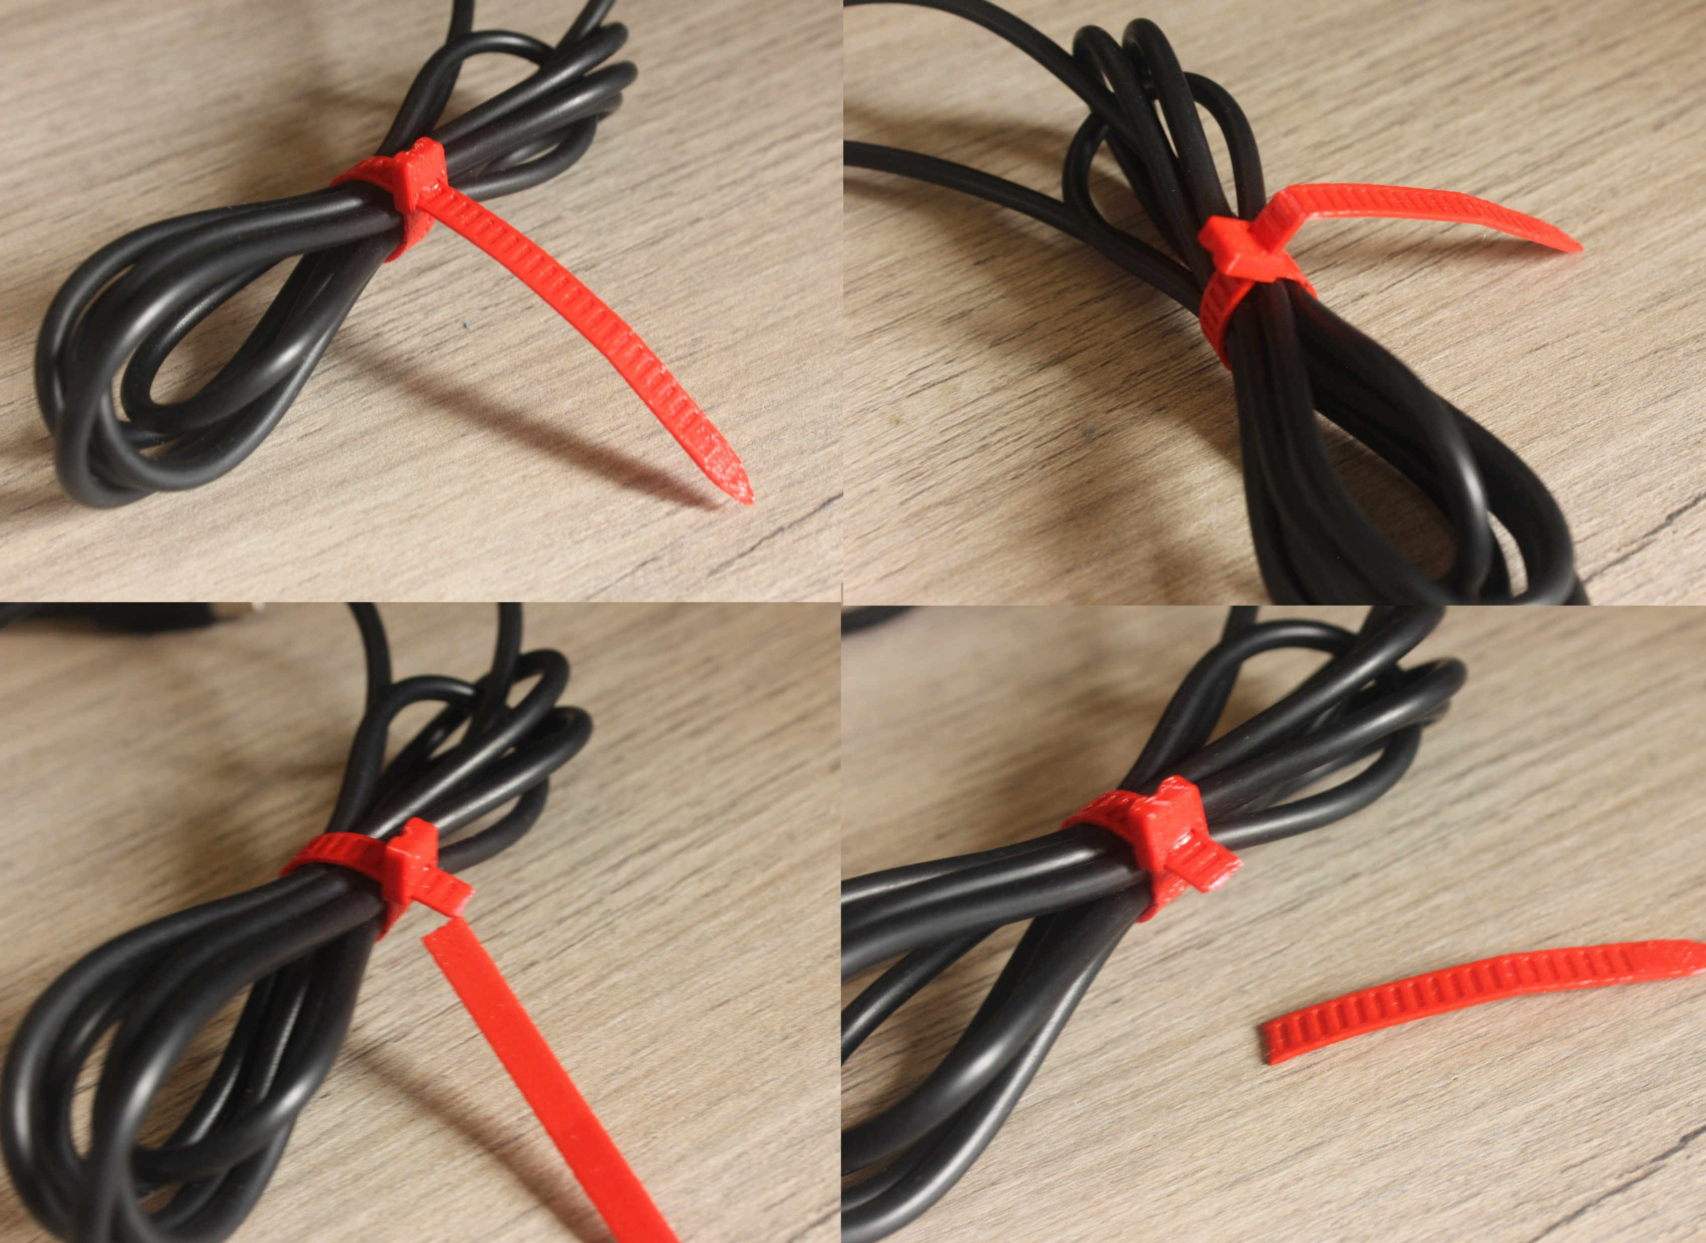
Rumors vs. Realities
Rumor: Traffickers use zip-ties or mark vehicles with coded letters and numbers (1F/1B) to target or abduct their victims.
Rumors about the use of zip ties or marking of vehicles by traffickers have been proven to be false.
Data from the U.S. National Human Trafficking Hotline from January 2015 to August 2022 found that there have been zero cases of zip ties being used as lures or markers that alert a potential trafficker of a vulnerable person.
This Photo by Unknown Author is licensed under CC BY-NC-ND

Slide 18

More United States citizens are trafficked within the United States each year than there are people trafficked into the United States from other countries.
Polarisproject.org
Polarisproject.org

Slide 19

Approx. 27 million people are enslaved today.
Trafficking is the 3rd largest illicit trade following drugs and weapons
Fastest growing crime worldwide
FBI.GOV

Slide 20
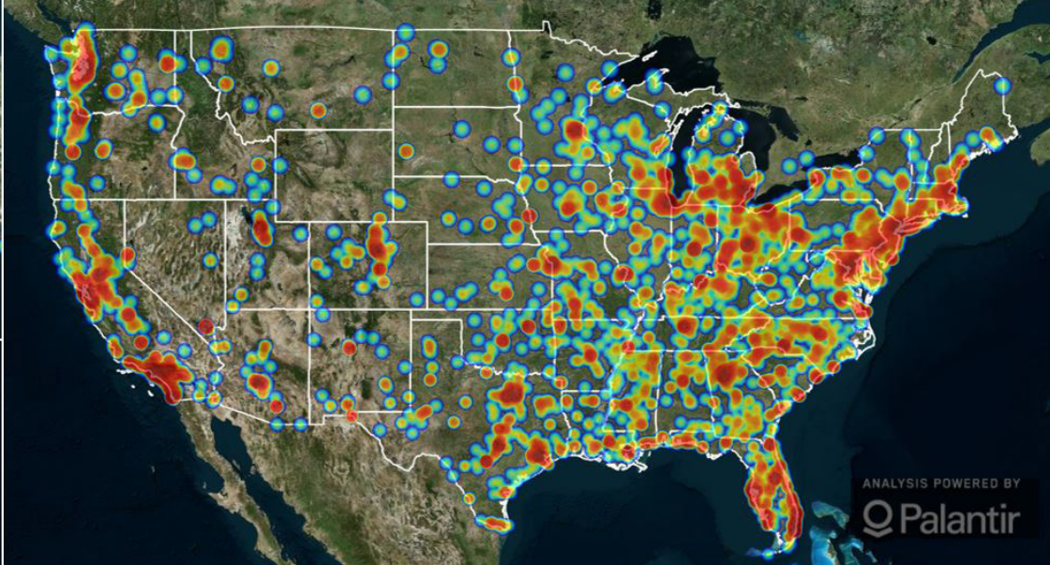
More than 65% of Human Trafficking Cases reported are Sex Trafficking.
Data from Polaris Project/National Human Trafficking Hotline 2021 Report

Slide 21
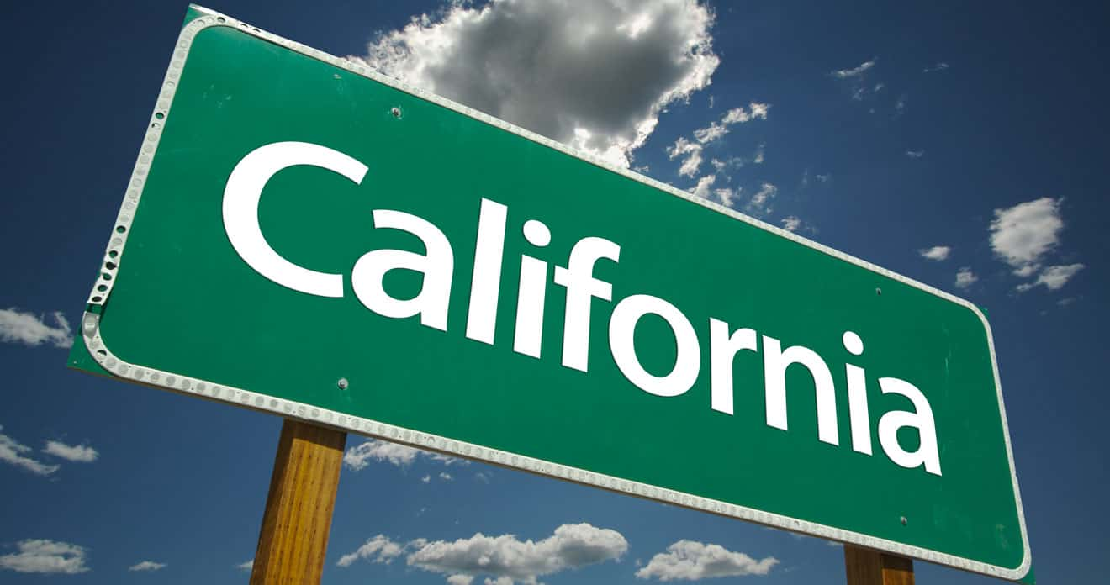
California Statistics 2023
3,152 calls were received by the Hotline in 2023 from California.
1,043 calls received were from victims or survivors of human trafficking
National Human Trafficking Hotline
This Photo by Unknown Author is licensed under CC BY-NC-ND

Slide 22
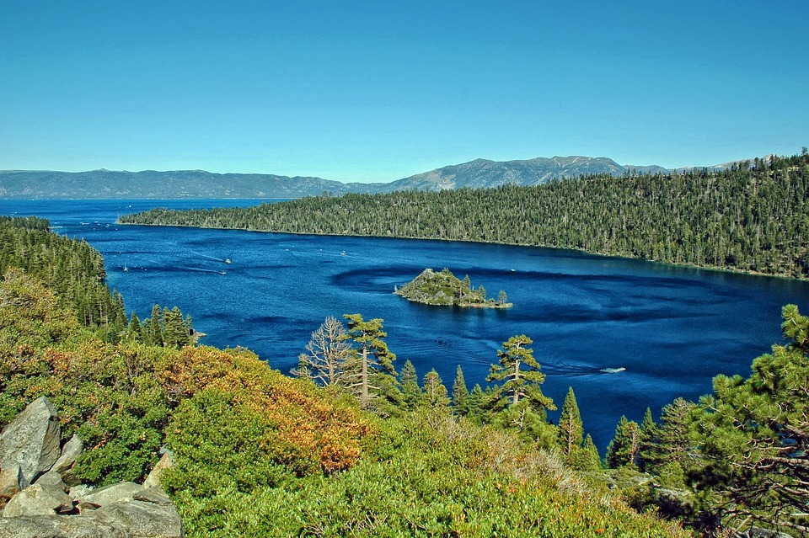
California Statistics 2023
Adult callers: 868
Minor callers: 297
Females: 860
Males: 178
National Human Trafficking Hotline

Slide 23

Two Types of Human Trafficking
1. Labor Trafficking
Forced work with little or no pay
Happens in agriculture, construction, restaurants, factories, domestic work
Victims may be threatened, controlled, or unable to leave
2. Sex Trafficking
Exploiting a person for a commercial sex act
Can happen to any gender, age, or background
Often involves manipulation, threats, or false promises

Slide 24

There are 2 main types of sex trafficking:
Survival Sex
Pimp/ Trafficker (using force, fraud, and coercion)

Slide 25
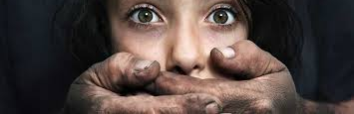
Average age when people start being trafficked ?
14-17 years old *varies depending on gender*

Slide 26

Sex Trafficking and age
Victim is under 18
No force or coercion is required by law
A minor cannot legally consent to commercial sex
Commercial Sexual Exploitation of Children (CSEC): Crimes of a sexual nature committed against juvenile victims in exchange for money, drugs, or other items of value. *

Slide 27

MISCONCEPTION:
Over 18=prostitutes/criminals.

Slide 28
80-90% of trafficking survivors have been sexually abused
****all ages should be viewed as victim and survivor****

Slide 29
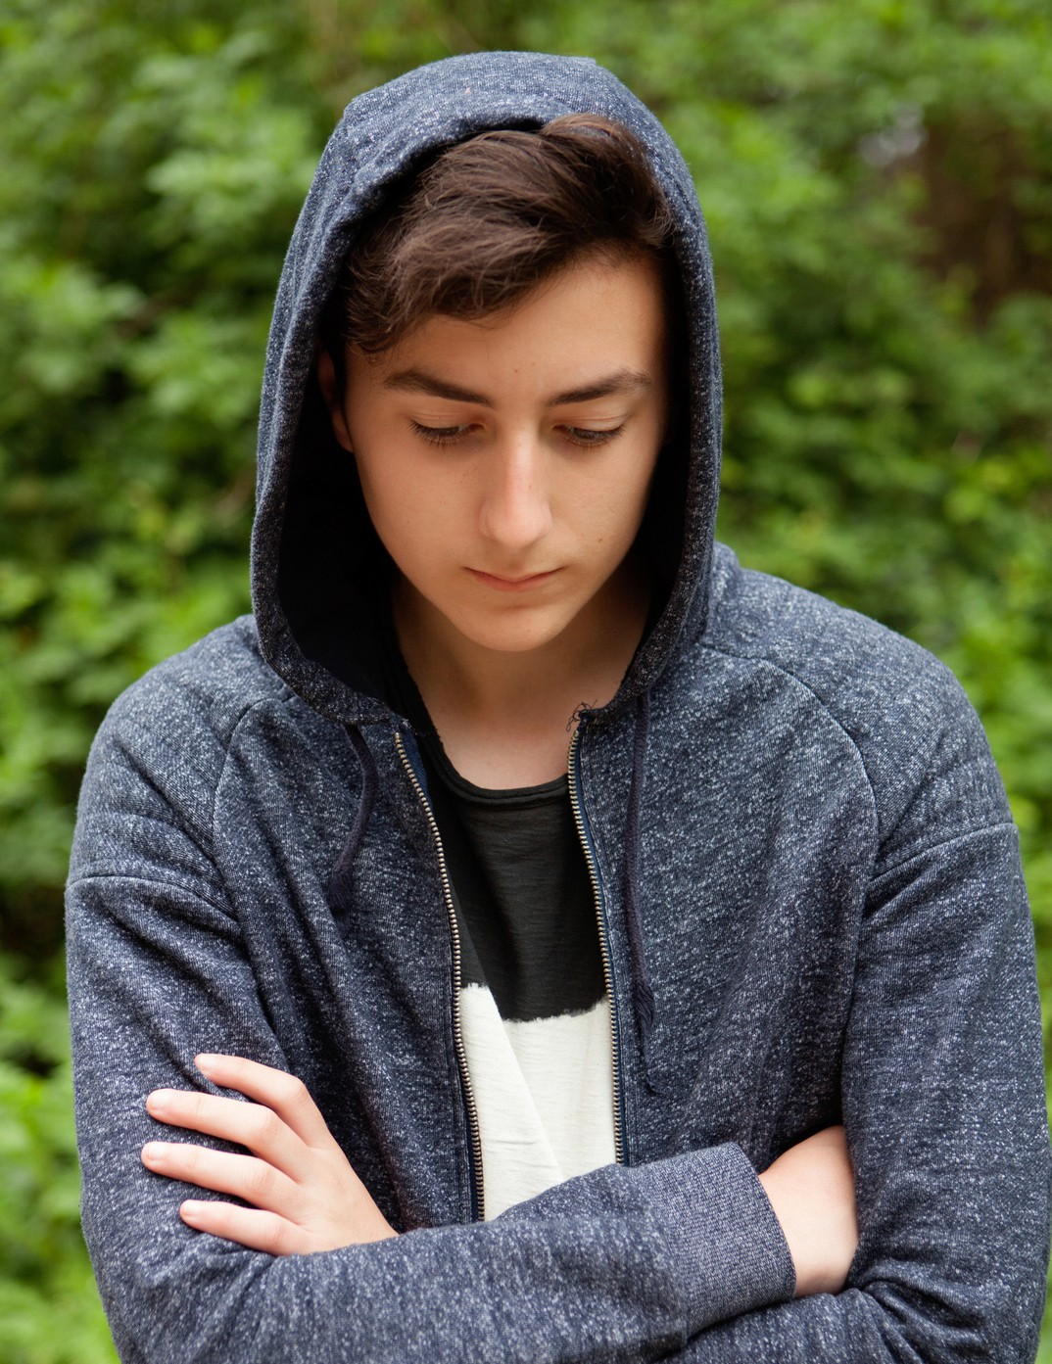
Commercially Sexually Exploited Men and Boys
There is little information about commercially sexually exploited men and boys. This may be attributed to underreporting and gender bias in reporting.
According to a New York study:
It was estimated that 70% experienced sexual abuse as children
LGBTQ+ youth made up one-third of sexually exploited young men
Two-thirds were heterosexual men engaging in ‘survival sex’, trading sexual activities for food, shelter, money, or drugs.
/Commercial Sexual Exploitation of Children in New York City, Volume One: The CSEC Population in New York City: Size, Characteristics, and Needs. 2008. Ric Curtis, Karen Terry, Meredith Dank, Kirk Dombrowski, and Bilal Khan

Slide 30
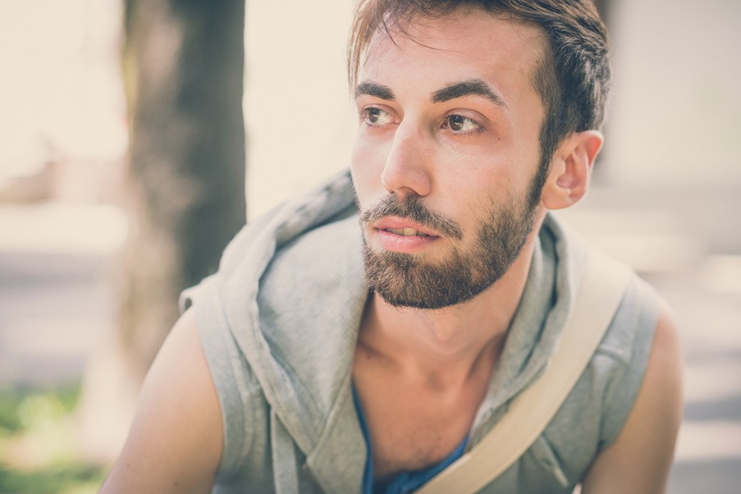
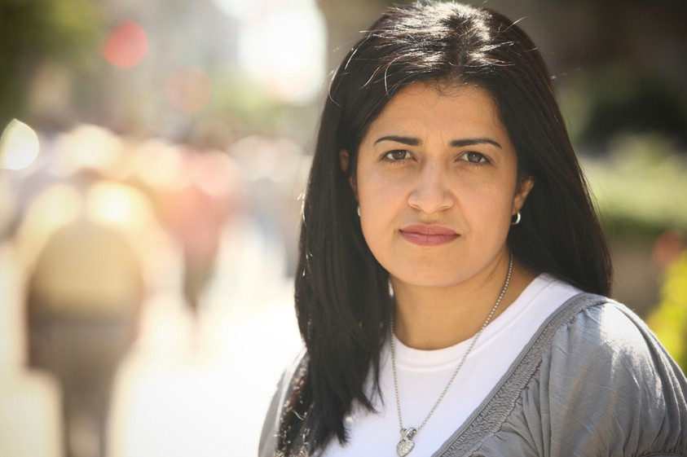
Reminder
Trafficking can happen to anyone - any age, race, gender, or nationality.

Slide 31

Anyone can be victimized by this crime….
But certain factors make it more of an unfair fight for some individuals.

Slide 32
Keep in mind that just because an individual may have one or many of these vulnerabilities, does not mean that they are a trafficking victim/survivor.

Slide 33
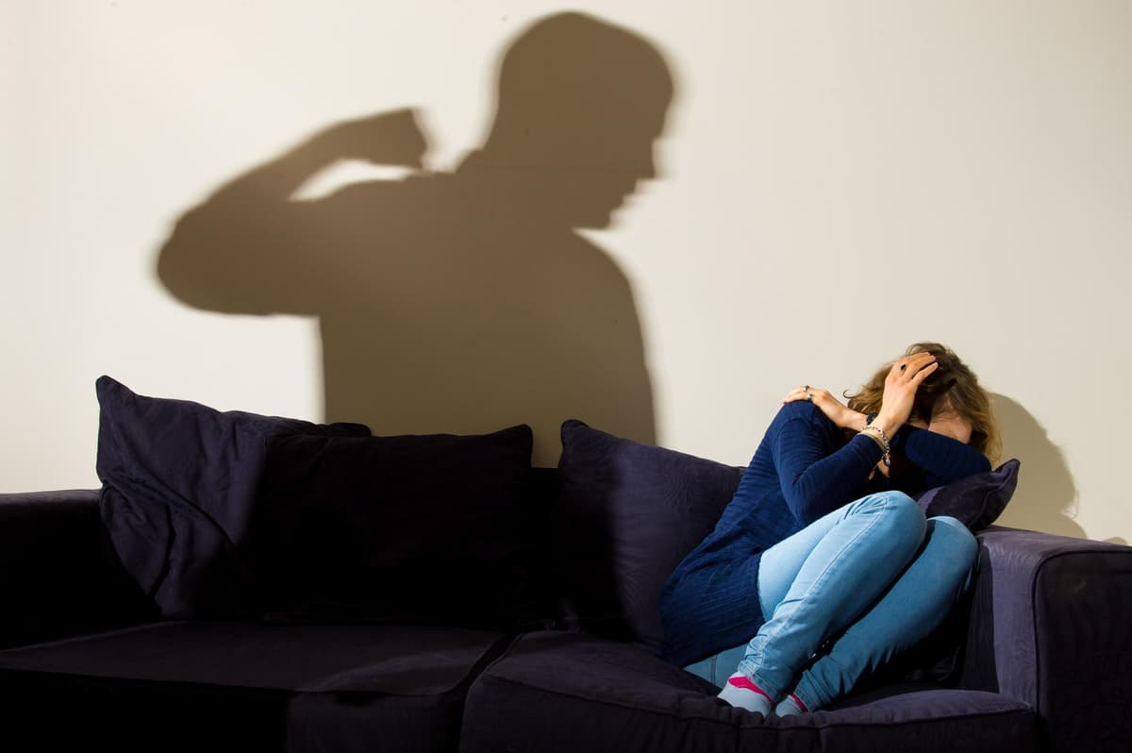
Family & Home‑Related Vulnerabilities
Unstable or unsafe home environments greatly increases risk Family conflict, abuse, or neglect Children experiencing physical, emotional, or sexual abuse may seek escape or validation elsewhere, making them targets for traffickers. Parental substance use or mental health issues Caregivers may be inconsistent or unable to provide supervision and protection. Housing instability or homelessness Youth who are runaway, homeless, or “couch‑surfing” often rely on strangers for basic needs. Foster care or child welfare involvement Frequent placement changes, lack of meaningful adult connections, and prior trauma increase vulnerability.

Slide 34

Individual & Social Vulnerabilities
Certain personal and social factors increase susceptibility Age and developmental stage Adolescents are more vulnerable due to identity formation, risk‑taking, and desire for independence. Social isolation or lack of support Youth who feel disconnected from family, school, or peers are easier to manipulate. Prior trauma or victimization Previous abuse can normalize exploitation and make grooming more effective. Discrimination and marginalization LGBTQ+ youth, youth of color, and immigrant or undocumented minors face higher risks due to stigma and lack of protections. Disabilities or cognitive impairments May hinder danger recognition or increase dependence on others.
This Photo by Unknown Author is licensed under CC BY-NC-ND

Slide 35
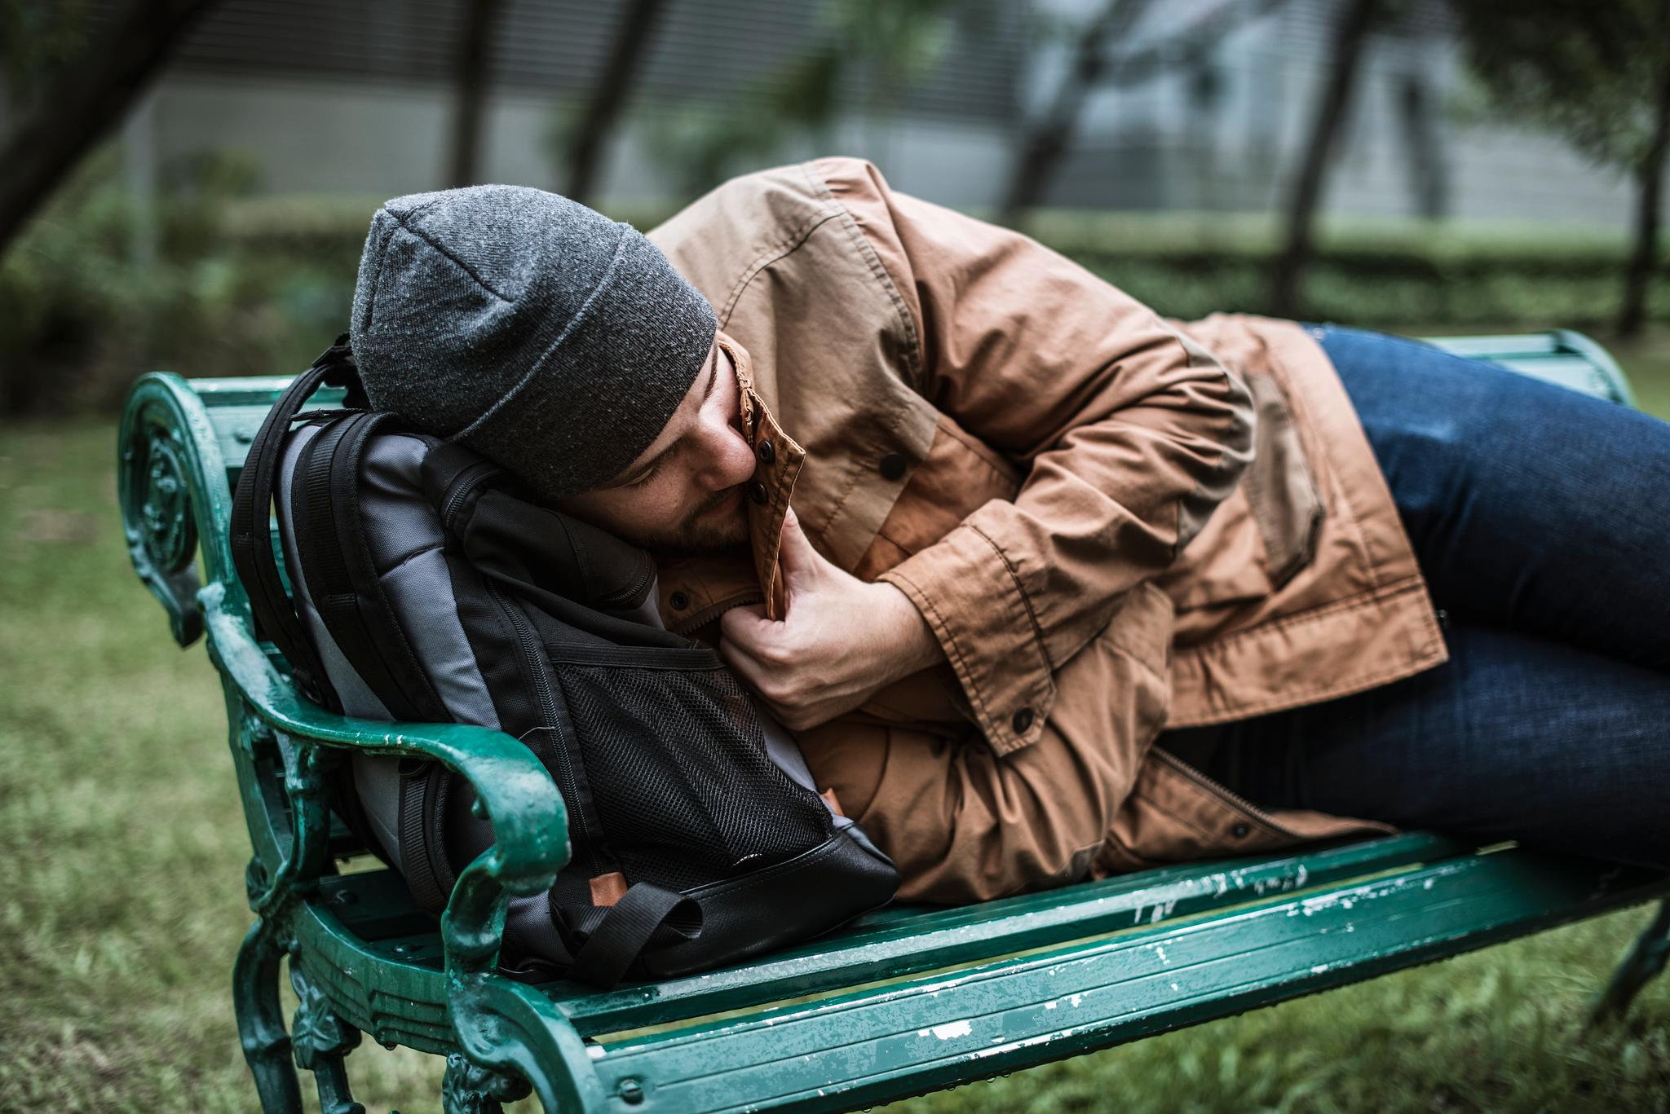
Economic & Systemic Vulnerabilities
Poverty and lack of basic resources Traffickers often offer food, money, shelter, or gifts in exchange for compliance. Limited access to education School disengagement reduces protective oversight and future opportunities. Community violence or high crime rates Normalization of exploitation and survival‑based choices. Online access without digital safety education Social media and gaming platforms are common spaces for grooming and recruitment. Language barriers or immigration status Fear of authorities and limited awareness of rights increases control by traffickers.

Slide 36
No single vulnerability causes trafficking. It is the intersection of personal, social, and systemic factors that traffickers exploit.”

Slide 37
Media Influences on Perception & Normalization
How content can reshape beliefs and expectations Sexualized or glamorized portrayals Music, videos, and influencer content may normalize exploitative relationships, “fast money,” or adult‑minor dynamics. Romanticized control and dependency Media narratives sometimes frame possessive behavior as love, masking warning signs of coercion. Desensitization to exploitation Repeated exposure to sexualized content can blur boundaries and reduce recognition of harm. Consumer culture pressures Emphasis on luxury, appearance, and status can increase vulnerability to offers of money or gifts. Media can unintentionally condition youth to accept exploitation as normal or desirable.

Slide 38



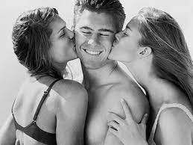

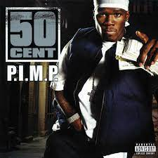
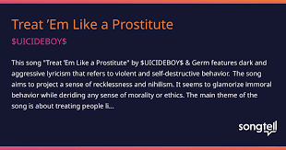

Slide 39


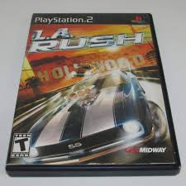

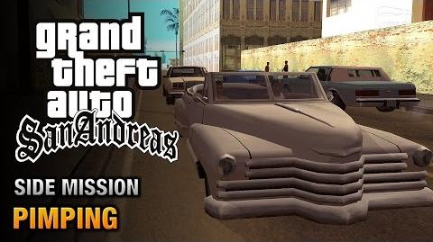

Slide 40
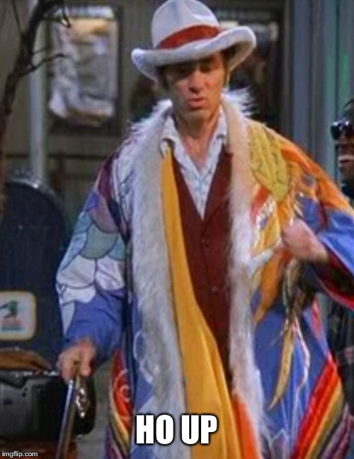

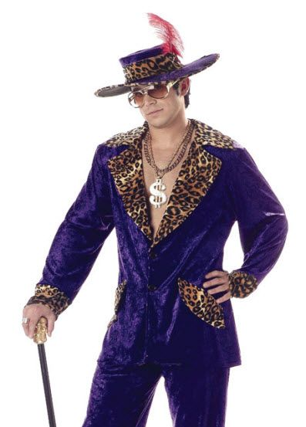
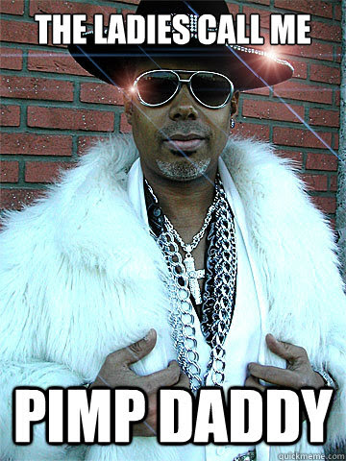
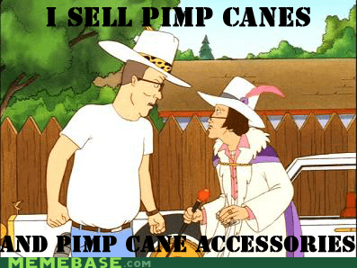

Slide 41
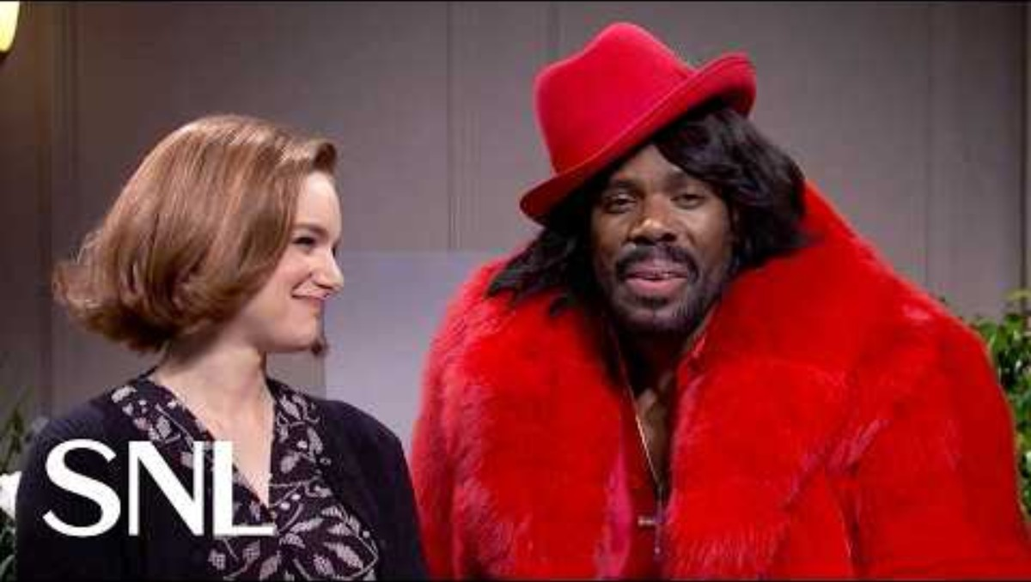

Slide 42
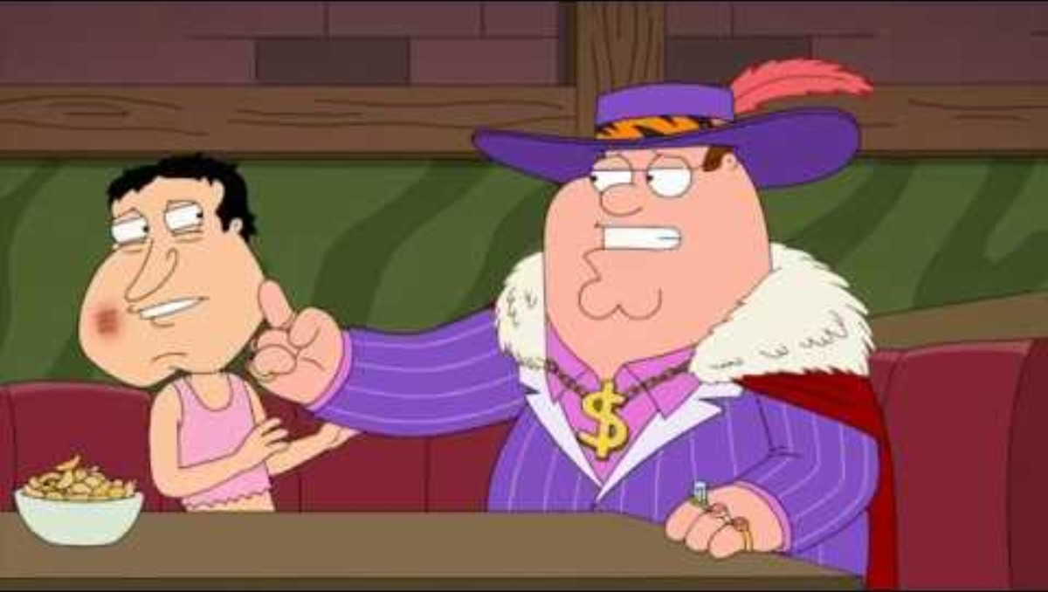

Slide 43
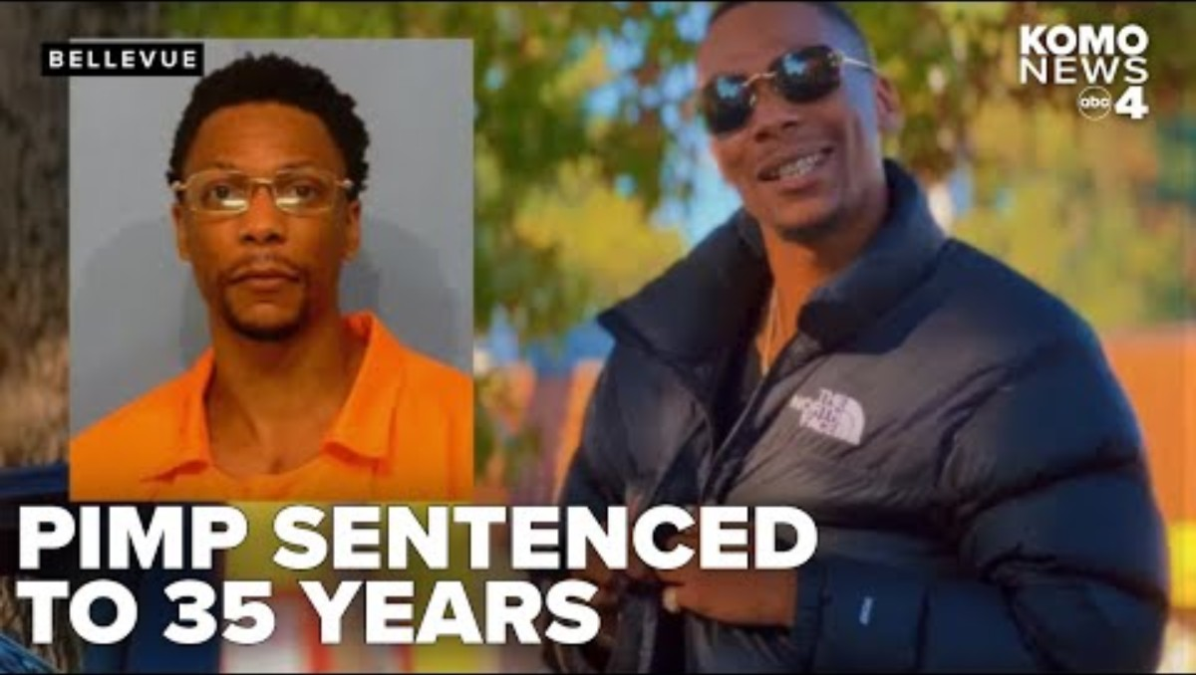

Slide 44

Media itself is not the danger—unchecked access, lack of education are what traffickers exploit.”

Slide 45

Human sexuality is not openly discussed in many American households, yet the topic is rampant in all forms of media seen by children, teens, and adults.
Many children/teens only learn about sex and sexuality through what they see online and in the media.

Slide 46
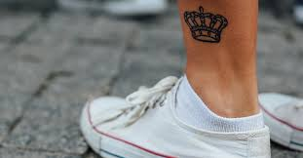

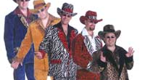
What is a Pimp?
A pimp is a person, usually male, who manages, controls, and exploits individuals involved in commercial sex, taking income from their earnings while often providing "protection" in exchange.
Pimping involves coercion, manipulation, and violence, often constituting a felony.
Pimps often brand their victims with a tattoo or mark to show that they are property
This Photo by Unknown Author is licensed under CC BY-NC

Slide 47

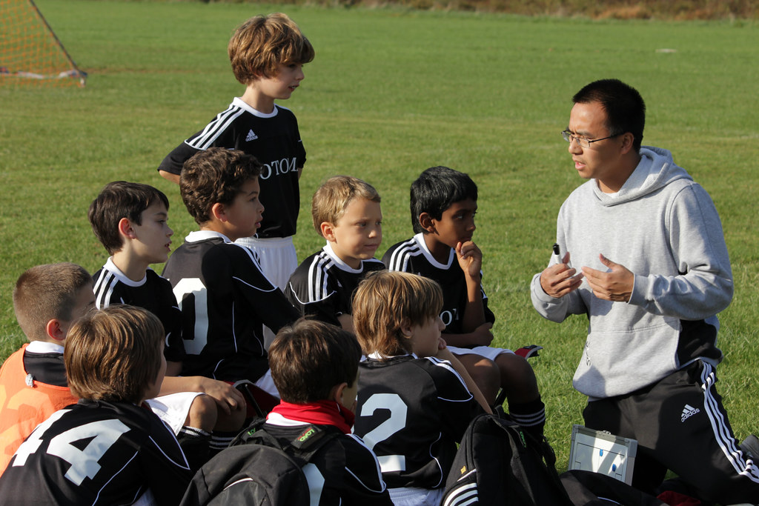
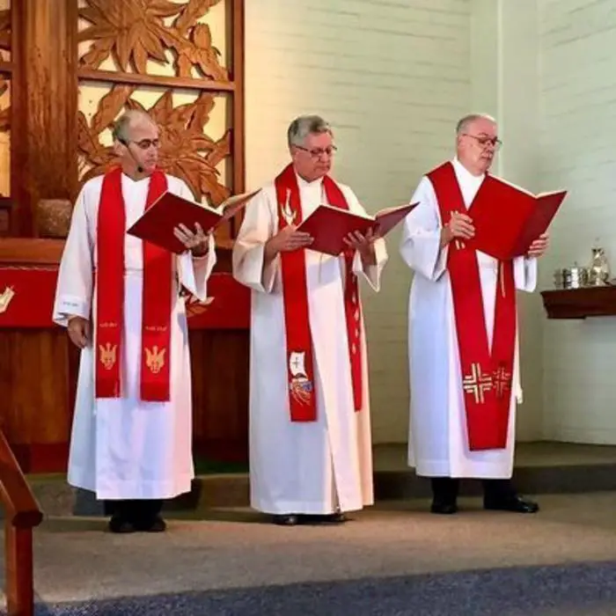
What is a pimp?
Pimps can look like an ordinary guy or girl.
  They can also be a family member who sells their child for food, money or drugs.
  Pimps can be female. They will act like the mentor or big sister.
  They are manipulators
  They are predators
Boyfriend/girlfriend/spouse/partner
Family members (cousins/brothers/sisters etc.)
Parents/guardians
Strangers
Business owners
Clergy
Gangs
Coaches/Mentors
This Photo by Unknown Author is licensed under CC BY
This Photo by Unknown Author is licensed under CC BY-SA

Slide 48
Recruitment does not rely on force—it relies on access, opportunity, and unmet needs

Slide 49
Physical Locations Where Recruitment Often Occurs
Public places where oversight is limited and youth may be unsupervised Schools and surrounding areas Bus stops, nearby parks, or after‑school hangouts where traffickers can observe and approach youth. Malls, movie theaters, and fast‑food restaurants Popular gathering spots where youth socialize and recruiters blend in easily. Public transit hubs Bus stations and light‑rail stops where minors may be traveling alone. Shelters and drop‑in centers Traffickers may loiter nearby, knowing many youth are experiencing instability. Recruitment often happens in ordinary, everyday places, not hidden locations.

Slide 50
Situational & Peer‑Based Recruitment
where trust is already established Through peers or romantic partners Minors may be recruited by someone they know or are dating. Parties or social gatherings Substances, confusion, and peer pressure can be exploited. Modeling, music, or influencer “opportunities” False promises of fame, money, or mentorship. Runaway and homeless situations Survival needs (food, shelter, protection) are leveraged quickly. Recruitment often comes from someone familiar—not a stranger.

Slide 51

Online & Digital Recruitment Spaces
This Photo by Unknown Author is licensed under CC BY-NC-ND
Virtual environments where traffickers gain private access Social media platforms Instagram, Snapchat, TikTok, Facebook, and X are commonly used to initiate contact. Gaming platforms and chat rooms Shared interests create fast trust and repeated interactions. Dating apps and “friend‑finding” apps Age misrepresentation and lack of verification increase risk. Comment sections and direct messages Recruitment often begins with casual compliments or emotional validation. Online spaces allow traffickers to reach youth instantly, repeatedly, and privately.

Slide 52
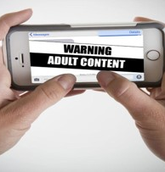
Online sexual exploitation
Sexting: the sending of a sexually explicit image on any device (phone, tablet, computer, etc.)
  Can happen between a child and a stranger but also happens with people you know.
  Sexting has become normal and is seen as flirting.
  Once an image is posted online, very difficult to remove and sometimes impossible to get the image removed.
  IT IS A CRIME TO CREATE, SEND, OR VIEW SEXUALLY EXPLICIT IMAGES EVEN IF YOU ARE UNDER THE AGE OF 18.
This Photo by Unknown Author is licensed under CC BY-SA-NC

Slide 53
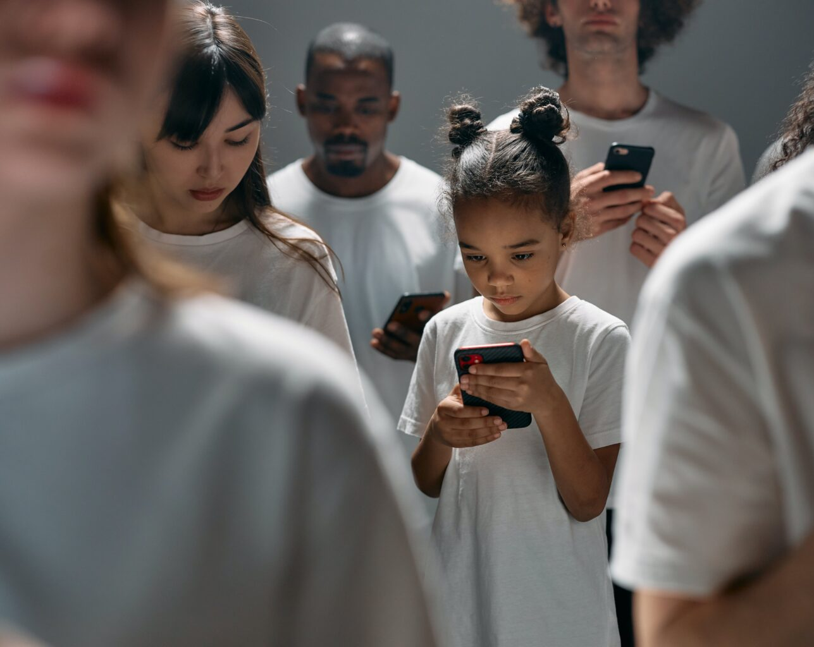
SEXTORTION
Online blackmail occurs when someone threatens to send a sexually explicit photo of another person unless they agree to send more explicit photos.
A minor who has been persuaded to send one image may be asked to send more including sexually explicit videos.
The reason a person will continue to send photos/videos is because they are afraid of their friends, teachers, or parents, finding out.
It is a crime even if you’re a minor.
This Photo by Unknown Author is licensed under CC BY

Slide 54

Revenge Porn
Someone shares private pictures that were meant only for them.
Usually done by an ex after a breakup.
Different from sextortion because the victim doesn’t have to do anything else.
The person sharing the images wants to “punish” and embarrass the victim.
This Photo by Unknown Author is licensed under CC BY-SA

Slide 55
What is grooming?
Traffickers carefully work to gain their victims’ trust, creating a degree of dependence.
They subtly promote the idea that selling sexual services is normal, acceptable, and necessary.
Ultimately, successful grooming results in vulnerable people cooperating in their exploitation and abuse and believing they have chosen to do so independently.

Slide 56
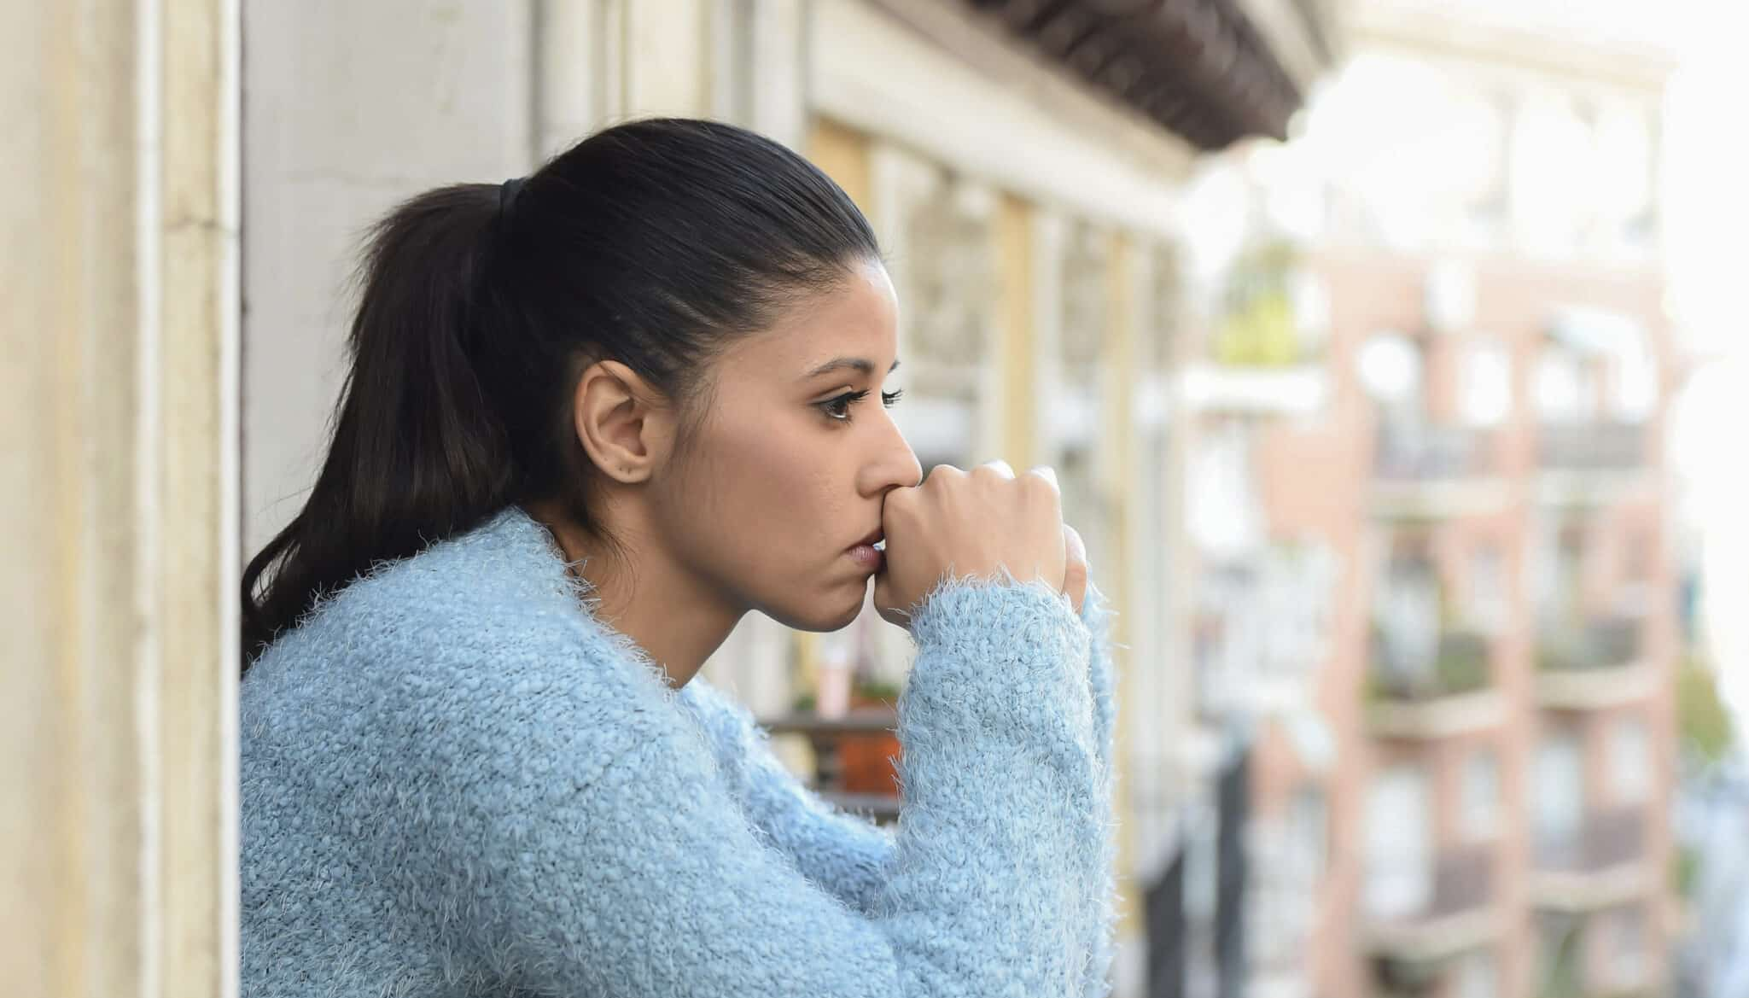
Common Stages of Grooming
1. Targeting
  Looking for someone who feels lonely, stressed, or unsupported
2. Building Trust
  Compliments, gifts, attention, sympathy
  Acting like a friend, mentor, or romantic partner
3. Isolation
  Encouraging secrecy
  Creating distance from friends, family, or adults
4. Control
  Using guilt, threats, fear, or shame
  Making the person feel like they “owe” them
Grooming is about manipulation, not choice.

Slide 57
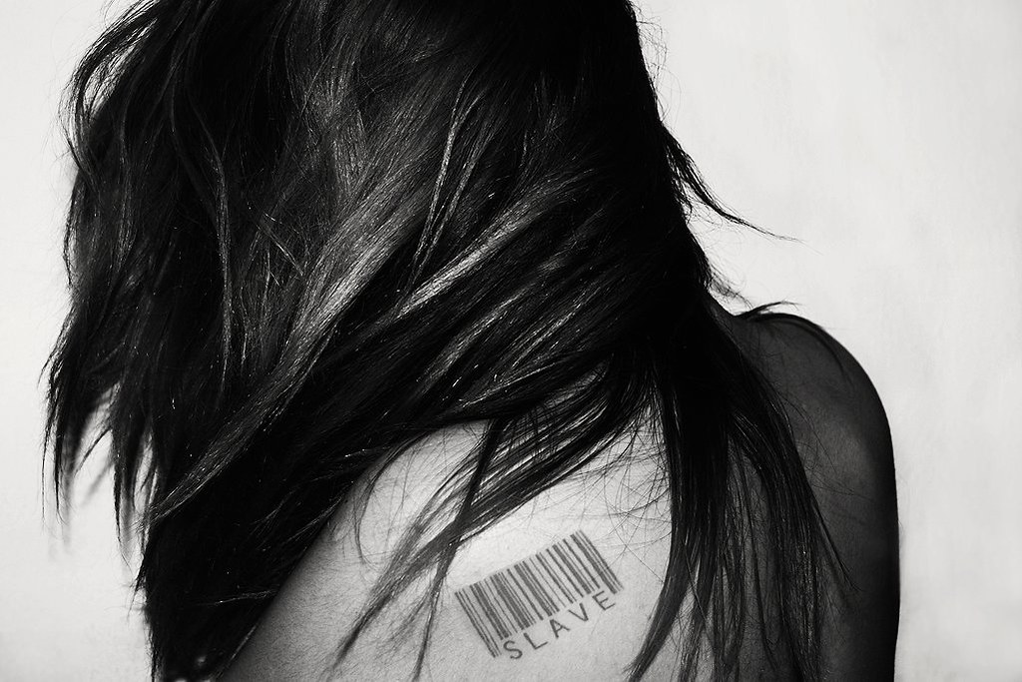
Why don’t they just leave the “life”
Survivors of human trafficking have reported….
  Feeling isolated
  Feeling embarrassed/ashamed
  Feeling responsible/blame themselves
  Feeling unsupported
  Forced to drop out of school or quit their jobs
  Feeling unworthy of assistance/help from others
  Fear of being triggered
  Fear of re-victimization
  Fear of being retaliated against by their trafficker, peers, family, etc.
  Fear of not being believed
  Having to re-tell their story multiple times to multiple people

Slide 58
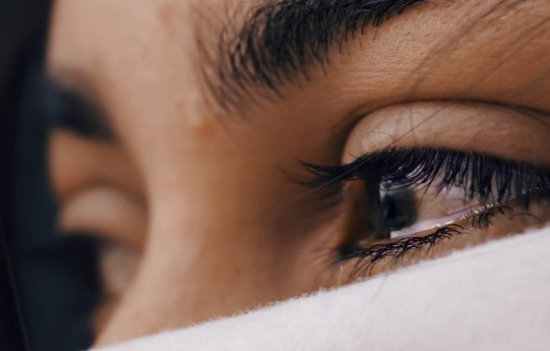
Trauma Bonding
Common among victims, especially youth victims, exploited for commercial sex.
The survivor experiences a strong link to the pimp/exploiter based on what the victim perceives as an incredibly intense or important relationship, but one in which there has been an exploitation of trust or power.
Emotional bonding is a learned tactic for survival and can be common between victims and the exploiter.
Notes:
What does this mean for survivors? How do we deal with survivors strong connection with their exploiter?

Slide 59
What are the effects of this trauma?

Slide 60

Health Impacts
Addiction
Anger related issues Anxiety
Chronic pain
Complications from unsafe abortion Depression
Fractures
Gastrointestinal problems Headaches
Head Injuries Memory problems PTSD
STI's
Sleep deprivation Suicidal ideation

Slide 61
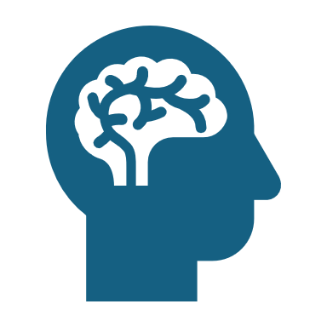
What makes HT survivors different?
Compounding, complex trauma
Fear of criminalization
Isolation, lack of trust
Transient, lack of documentation
The transactional nature of their interactions makes communication challenging.

Slide 62

What we are seeing in Placer County...
Placer and Sacramento residents trafficked in Placer County
High schools in Placer County
Connection between Bay Area counties
Caucasian, Hispanic, African American & multi-racial
Previous sexual assault, family violence, and involvement with the "systems"
Runaways, truancy, lack of family support system
Generational cycle of violence
Exploitation ONLINE and at hotels/motels, parks, homes, and casinos
This Photo by Unknown Author is licensed under CC BY-SA

Slide 63
Often trafficking survivors connect with organizations initially as other survivor types, i.e., domestic violence or sexual assault survivors.

Slide 64
Recognizing sex trafficking
Sex trafficking is not something you can see happening across a crowded room.
It is not a crime that occurs in an instant, like a kidnapping or carjacking, that a bystander can witness and report.
Many people in active sex trafficking situations do not recognize themselves as being victims because they have been groomed by a trafficker to believe they have chosen to participate in commercial sex.
Understanding how sex trafficking works can help families and communities recognize vulnerable people before they become victims and provide survivors with the support, they need to break free, heal, and move on with their lives.

Slide 65
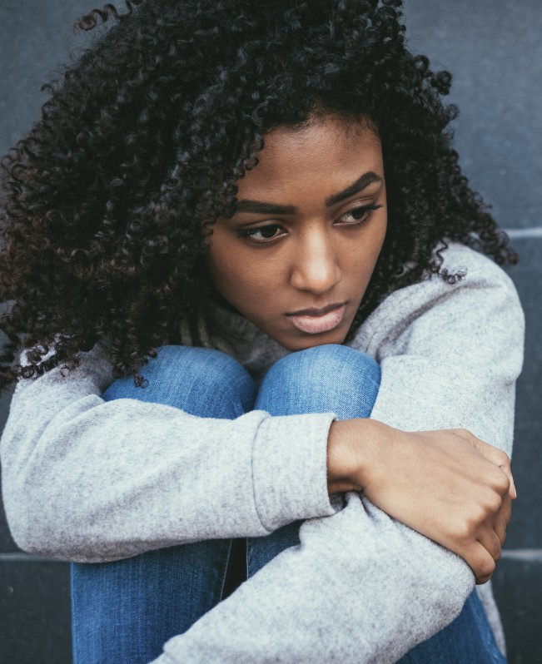
Potential Indicators
Acting fearful, anxious, or angry
Unable to speak on their own behalf Evidence of being controlled
Signs of abuse Inconsistency in stories
Threatened with harm or deportation Lives and works in the same place.
Identifying survivors
Survivors of trafficking may not self-identify and may resist efforts to force disclosure. Meeting the stated or immediate needs of the person will help create the conditions for disclosure.

Slide 66
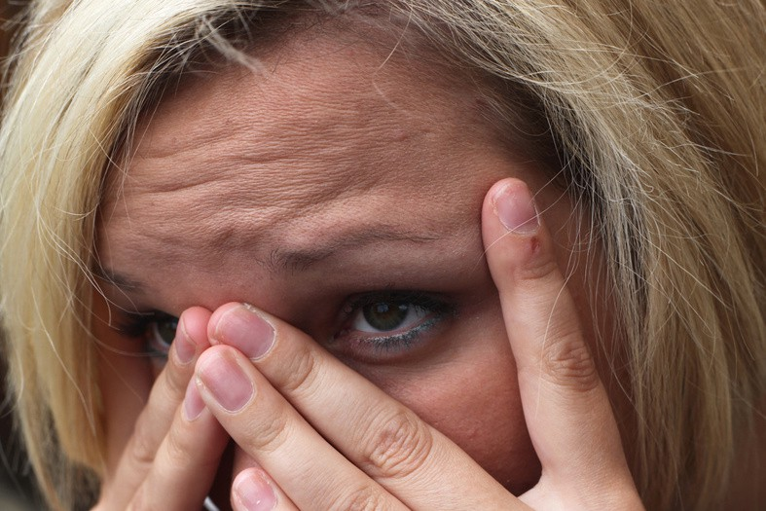




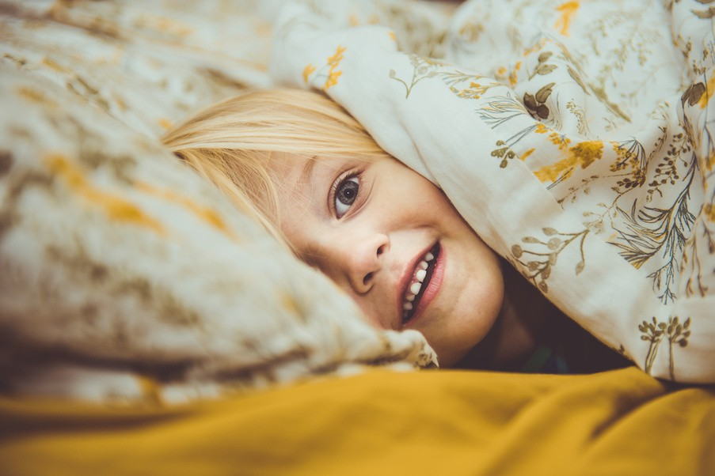




Common Experiences
No control over working hours Little or no pay
Inhumane conditions
Threats to person, family, or children Physical, psychological or sexual abuse Confiscated documents
Dependency on trafficker for housing Limited access to preventative care
"If I left, where would I go?"

Slide 67
What can you do?

Slide 68

Use a Survivor‑Centered, Trauma‑Informed Approach
Safety, choice, and dignity come first
Believe survivors
  Avoid questioning credibility or minimizing experiences.
Prioritize safety and autonomy
  Survivors should control decisions about services, reporting, and next steps.
Avoid re‑traumatization
  Limit repetitive questioning and invasive details.
Use respectful, person‑first language
  Focus on the individual, not the exploitation.
Healing begins when survivors are treated as experts in their own lives.
This Photo by Unknown Author is licensed under CC BY-NC-ND

Slide 69



Support Access to Basic Needs & Stabilization
Meeting immediate needs creates the foundation for recovery Safe housing Emergency shelter, transitional housing, or survivor‑specific programs. Food and essential items Reliable access reduces survival‑based risks. Medical and mental health care Includes trauma‑informed physical and behavioral health services. Transportation and childcare Removes barriers to appointments, work, and education. Survivors cannot focus on long‑term healing without basic stability.
This Photo by Unknown Author is licensed under CC BY-NC

Slide 70

Provide Long‑Term, Holistic Support
Recovery is ongoing, not linear Trauma‑specific counseling Including culturally responsive and survivor‑choice modalities. Education and job readiness GED programs, vocational training, and career pathways. Life skills development Financial literacy, communication, and healthy relationship skills. Peer support and survivor leadership Shared experience fosters trust and empowerment. Long‑term success requires time, consistency, and flexibility.
This Photo by Unknown Author is licensed under CC BY-SA-NC

Slide 71
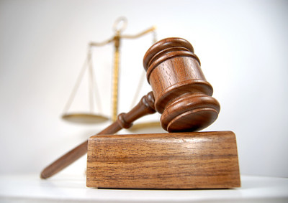
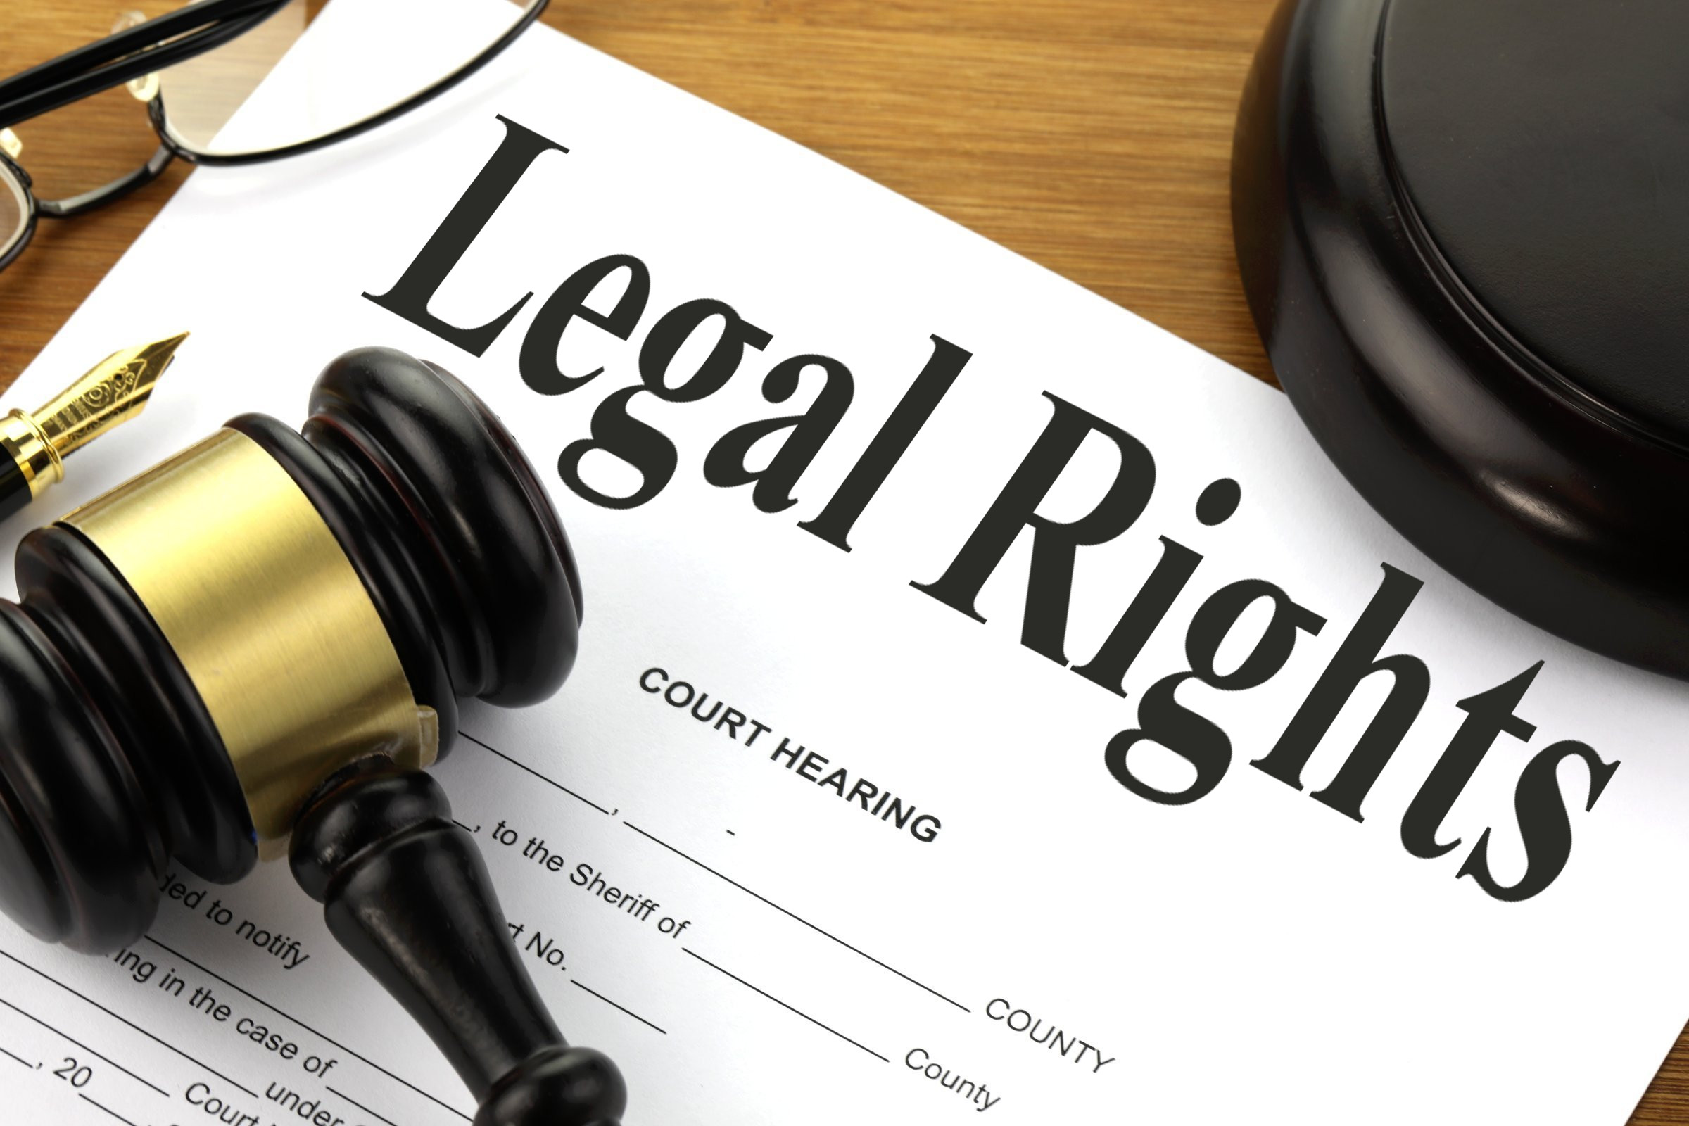
Respect Legal Choices & Offer Advocacy
This Photo by Unknown Author is licensed under CC BY
This Photo by Unknown Author is licensed under CC BY-SA
Not all survivors want or are able to engage with the justice system Explain options without pressure Criminal, civil, immigration, or restorative pathways. Provide legal advocacy Assistance with restraining orders or victim compensation. Accompaniment and court support Survivors should not navigate systems alone. Justice looks different for every survivor.

Slide 72

Strengthen Community & Prevention Efforts
Communities play a critical role in survivor well‑being Educate and train professionals Teachers, healthcare workers, law enforcement, and service providers. Build cross‑system collaboration Coordination between housing, healthcare, child welfare, and advocacy groups. Reduce stigma and victim‑blaming Public messaging that promotes empathy and understanding. Listen to survivor voices Survivors should help shape policies, programs, and responses. Supporting survivors is both an individual and collective responsibility.

Slide 73
The goal is not rescue—it is restoration, empowerment, and choice

