Slide 1
Sexual Assault Response Team
Notification & Response Procedures
Exams
VAWA
Strangulation
SART Advocate Roles
Survivor Rights
Cultural Considerations
Becoming Part Of The Team
Presenter: Isabel Valles, SART Coordinator

Slide 2
Notification & Response Procedures:
How is a SART exam initiated?

Slide 3
Protocols
SART protocols are agreements between agencies about the provision of sexual assault services and the roles and responsibilities of core responders.
Ultimately, protocols provide a way for team members to institutionalize inter-agency expectations to maintain high quality, consistent responses over the long-term.

Slide 4
Protocols In Place Right Now
LE reports all Sexual Assaults to Stand Up Placer (if LE is involved)
After the exam, SUP has 72 hours to respond, 24 hours to make first attempt
DOJ has 120 days to get SAFE kit full completed.

Slide 5
How An Exam Happens
Survivor discloses assault to LE/Hospital Staff/Social Worker
LE/Hospital Staff/Social Worker calls Crisis Line to order an exam
Crisis Line add the SANE to the call to collect data about the case
During 3-way call - time and place for exam is set up and authorization is sent to SANE
Crisis Line dispatches volunteer advocate
Survivor, advocate, and nurse meet at hospital for forensic exam

Slide 6
Where do the SART exams occur?
Sutter Auburn Faith Hospital (SAFH)
Sutter Roseville Medical Center (SRMC)
BEAR Clinic in Sacramento (if Placer County SANE is not available)

Slide 7
What happens during an exam?
Survivor arrives to hospital
LE takes initial statement
SANE/SAFE completes an interview
Forensic exam takes place- collecting DNA, uranalysis
Survivor may get medicine for STDs
Hospital staff medically clears survivor

Slide 8
What happens after the exam?
SUP reaches out to offer services within 72 hours
Detective will be assigned to the case, usually within 2 weeks (May reach out for a Pre Text phone call)
LE may go silent as the investigation proceeds- expect 6-8 weeks for DNA to come back if not longer
DA will make decision whether there is enough evidence to prosecute

Slide 9
Crime Lab
Rapid DNA Testing – RADS Program
  Depending on several factors, a crime lab may take 3 month to one year to process a sexual assault kit.
  The RADS program (Rapid DNA Testing) allows for 3 swabs to be processed within 30 days. The SANE accesses which are the most probative swabs (based on investigative interview) and submit those.
  California voters passed Proposition 69, the “DNA Fingerprint, Unsolved Crime and Innocence Protection Act in November 2004”, which expanded the RADS program to all 46 counties.
  Sacramento crime lab is known nation wide for their success and organization in filing DNA.
  Quantico is even aware of how great of a job Sacramento is doing.

Slide 10
What if the Survivor does not want to involve Law Enforcement?

Slide 11
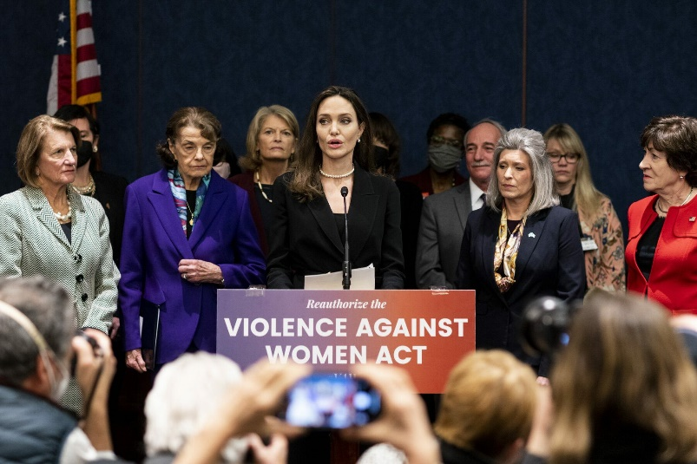
Violence Against Women Act (VAWA)
On March 15, 2022, President Joe Biden signed into law the Violence Against Women Act Reauthorization Act of 2022, bipartisan legislation passed by Congress as part of the Omnibus appropriations package. As a U.S. Senator, Biden wrote and championed the groundbreaking Violence Against Women Act (VAWA) landmark legislation that first passed in 1994.
Since 1994, VAWA has been reauthorized and strengthened three times: in 2000, 2005, and 2013. Although VAWA was slated to be reauthorized in 2019, that did not occur.
While incidents of domestic violence and sexual assault have declined significantly since VAWA first took effect—and efforts to increase access to services, healing, and justice for survivors have improved with each iteration of VAWA—much work remains.

Slide 12
Violence Against Women Act (VAWA)
2022 Reauthorization of VAWA
Reauthorizing all current VAWA grant programs until 2027 and, in many cases, increasing authorization levels.
Expanding special criminal jurisdiction of Tribal courts to cover non-Native perpetrators of sexual assault, child abuse, stalking, sex trafficking, and assaults on tribal law enforcement officers on tribal lands; and supporting the development of a pilot project to enhance access to safety for survivors in Alaska Native villages.
Increasing services and support for survivors from underserved and marginalized communities—including for LGBTQ+ survivors, culturally specific services as well as services in rural communities.
Establishing a federal civil cause of action for individuals whose intimate visual images are disclosed without their consent.
The Keeping Children Safe From Family Violence Act (Kayden’s Law). Strengthens state courts' abilities to recognize and adjudicate domestic violence and child abuse allegations.

Slide 13
Benefits of VAWA
No cost to the survivor – law enforcement still pays for the exam
The evidence is collected “anonymously”
Not required to file a report or participate with law enforcement
Ability to swab and collect time sensitive evidence while allowing the survivor time to process their choices and make the decision that is best for them
Allows the survivor to take their time or make a fully informed decision when pressing charges

Slide 14
Disadvantages of VAWA
In some counties, the kit is not automatically processed. The kits are held until the survivor decided to make a police report. Law enforcement then decides to authorize the processing of the evidence
While come counties have a statute of when a kit must be processed (for example within 2 years) before it is destroyed.
Sacramento and Placer County hold kits indefinitely and process under a "jane doe"

Slide 15
Why is Strangulation Important to Know About in Relation to SARTs?
7.4 % of all female sexual assault cases involved non-fatal strangulation (NFS)
58% of sexual assault cases involving non-fatal strangulation was perpetrated by an intimate partner

Slide 16
Importance of Understanding The Impact of Strangulation
Strangulation is one of the most lethal forms of domestic violence: unconsciousness may occur within seconds and death within minutes
There is a risk for Traumatic Brain Injury, even if the person did not lose consciousness or the strangulation occurred only briefly
If your partner has strangled you in the past, your risk of being killed by them is 10 times higher (The Hotline.org)

Slide 17
What is a Sexual Response Team Advocate?
What do they do and provide?

Slide 18
What is expected of a SART Advocate?
Baseline qualifications: CIT trained, shadowed 1 or more exams, and has their SART bag with clothing, comfort items (snacks, fidget toys, journals), and SUP brochures
At Hospital within the hour of the call
Sober and coherent
Maintain confidentiality
Documentation of exam, survivor follow up information
You are there to be whoever the survivor needs- they may want you there for the exam or they may ask you to wait outside until it is done. You are bringing clarity into confusion, and empathy into a scary place. Be mindful of your body language and word choice.

Slide 19
Keep in mind…
Not all survivors want you there.
Not all survivors understand the legal system.
Not everyone is going to handle this the way that you would.
While yes, some things are infuriating, it is important to keep your focus on the survivor.

Slide 20
A SART Advocate’s behavior makes a difference:
Allow the survivor time to fully express him/herself- a lot of the exam will be listening
Silence is not always a bad thing
Speak clearly, slowly and quietly
Mirror the survivors body language
Respect Personal Boundaries
Use supportive and empowering language
Mindset of which you approach your time with the survivor- you cannot change what happened, but you can support them
The time in the hospital doesn't have to be depressing

Slide 21
Things to be Conscious of:
The assault is NEVER the survivor’s fault, no matter what the surrounding circumstances are
Be mindful of victim-blaming language and advocate for the client if it is being used
NEVER assist with gathering evidence during the exam, even if you are asked to by the SANE or LE
Not all survivors respond to trauma in the same way (ex: laughing vs. clamming up)
Not all survivors are female or have a straight sexual orientation
Most survivors are assaulted by someone they know, this can further traumatize the survivor and the decision to ‘press charges’ is often complex
Not all survivors have accepted what has happened to them, so be careful of the language you use
Be culturally sensitive
Forensic exams can be overwhelming and feel invasive for survivors – be empathetic and supportive

Slide 22
What is required for SART Advocates to take with them?
1. Phone/tablet
  This is for documentation
2. S.A.R.T. Packets
  This has SUP brochures, pamphlets that explain the survivor's rights, self care tools
3. Survivor/SART Bag
  Clothing
  Snacks and water/juice
  Self care products and hygiene items
  Comfort items such as teddy bears and blankets
  Fidget toys
  Toys for little ones

Slide 23
Documentation
The online form must be turned in within 48 hours so that we are able to follow-up with survivors.
Be aware of how the client is mentally while asking them questions
You will be able to fill out several blanks on forms if you are present for the LE interview/ SANE interview
Avoid asking minors questions about the assault.
Try and limit how much you ask them for the paperwork, you are probably the 7th person to ask them their story
Remind the client, “You are in control”
We work for the client, not medical staff or LE, etc. It is important for the client to know that there is no hidden agenda with their advocate
MOST IMPORTANT INFORMATION IS THEIR PHONE NUMBER

Slide 24
Rights of the Survivor
Privacy and confidentiality
Key Confidentiality Principles
    All information about the survivor, stated or inferred, belongs to the survivor- only other advocates with CIT training hold confidentiality
    A survivors’ decision to disclose information must be voluntary and free from pressure
    Advocates can release information only with the informed consent and authorization of survivor
      The paper form of this is called Release of Information or ROI
    A survivor can withdraw the authorization to release information at any time

Slide 25
Rights of the Survivor
SART- Forensic Exam
Access a forensic medical exam (SART exam) – age of consent is 12 years old. Therefore, parental consent is not required.
DNA can be collected for up to 5 days
  Exams available for an anal assault, forced oral copulation and strangulation as well
  Right to refuse any part of the exam, the entire exam or stop it once it has already begun
  Access a VAWA “confidential” abbreviated exam to prevent having to cooperate with LE-evidence is stored

Slide 26
Rights of the Survivor
Law Enforcement
Survivor has the right to have an advocate and a support person present when being questioned by law enforcement (MDIC exception)
Report to law enforcement or remain confidential

Slide 27
Rights of the Survivor
File a TRO, either DV/CH
CalVCB
Therapy
  Access therapy services – over the age of 12 WPC
    SUP offers 10 free therapy sessions
    We also work with the Victim Compensation Board to get survivor’s 40 free sessions that do not expire

Slide 28
Challenges with Confidentiality
Pressures to violate confidentiality
Advocates as interpreters
Survivors who disclose that their medical exam is due to sexual assault or spousal rape cannot be guaranteed confidentiality because hospitals and health care providers are required to report to the local law enforcement agency all cases in which medical care is sough or suspected where injuries have been inflicted upon the victim. The report must be made by phone and in writing and include the name of the injured person, her or his current whereabouts, and the character and extent of injuries. (Calif Penal Code Sections 11160-11161.1)

Slide 29
What is Title IX?
Landmark federal civil rights that prohibits sex discrimination in education
Does not apply to ONLY female students
Schools must be proactive in ensuring that their campus is free of sex discrimination
Schools must have established procedures for handling complaints of Sex discrimination, harassment, or violence,
Schools should ensure that a victim doesn’t have to share spaces, such as dorms, classes, or campus jobs, with their assailant.
Schools may not retaliate against someone filing a complaint and must keep the victim safe from other retaliatory harassment or behavior.
Schools can issue a no-contact directive to prevent the accused from approaching or interacting.
Schools are prohibited from engaging or allowing mediation of the complaint.
Schools can not discourage you from continuing your education.

Slide 30
Best Practices and Cultural Considerations Related to Advocacy and Forensic Exams

Slide 31
What is Culture?
Race and ethnicity, including sensitivity to gender, age, disability, language, literacy, sexual orientation, and any set of beliefs that guide an individual

Slide 32
Why Recognize Culture?
A victim centered response to sexual assault recognizes that underserved populations – women of color, low-income people, undocumented women, persons of disability and LGBT populations are disproportionately impacted by sexual assault.
Minority cultures/populations may have a fear or lived experienced of not being believed or offered the same services as white, cis, women

Slide 33
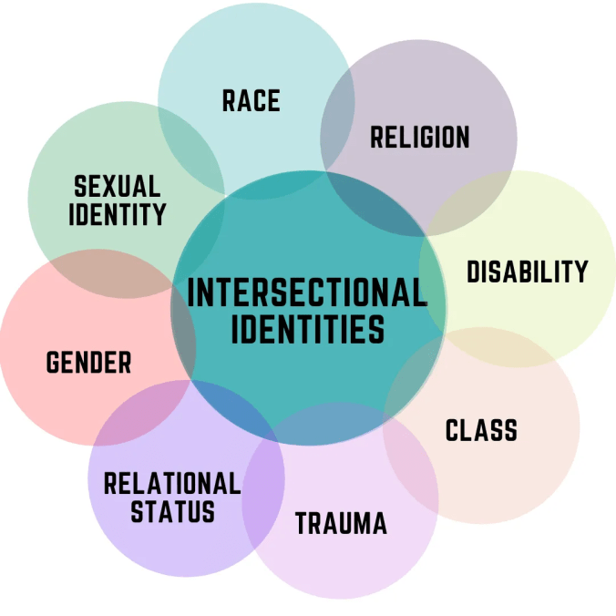
Intersectionality
A framework that examines how multiple systems of oppression and social identities interact to create unique experiences for people
Intersectionality is based on the idea that oppression is linked and that people are often disadvantaged by multiple sources of oppression. For example, a Black woman's identity as a woman and as Black are interlocking, meaning each identity informs the other and creates a complex convergence of oppression

Slide 34


Slide 35
Sexual Violence and the LGBTQIA+ community
This population is at a higher risk of sexual violence, they have a lower likelihood of reporting and they have less access to resources.
Studies suggest that half of trans people and bisexual women will experience sexual violence at some point in their lives.
21% of TGQN (transgender, genderqueer, nonconforming) college students have been sexually assaulted, compared to 18% of non-TGQN females, and 4% of non-TGQN males.
The recent reauthorization of the VAWA Act extended to include LGBTQIA+ people.
The use of someone’s sexual orientation has been used in the past to discredit survivors or minimize their trauma.

Slide 36
How To Be A Culturally Mindful Advocate
Be mindful and take inventory of your own bias and how they may influence how you interact with a survivor
Implement a zero tolerance policies for harassment, discrimination, racist language or homophobia.
Commit to personal growth and learning about identities outside your own
  Through continuing education and “on the job training” by talking about culture with the survivor
Discuss with the survivor if they have fears related to their culture and past experiences
Do not be afraid to ask- by avoiding the subject it may cause more harm than asking the survivor to share their experience
  Ex: what are your pronouns? How do you identify?

Slide 37
Creating A Culturally Mindful Organization
Providing translation and/or documents in that survivor’s language
Welcome and encourage people of color to become sexual assault advocates
  Create a space where survivors feel comfortable talking about issues of race and their experience
Reducing access barriers
  Understanding that survivors may have a fear of formal systems and lack of familiarity with available services (this is where understanding our bias comes in- one cannot assume someone may know what you know regarding the legal process or what resources are available to them)

Slide 38
Creating a Culturally Mindful Environment for Forensic Exams:
Informed consent on procedures
Terminology used throughout the exam
Client experience through the exam to ensure services after the exam
Considerations of survivors language preference, clothing preference, etc

Slide 39
The Bottom Line…
We all have different experiences and upbringings- part of our advocacy is doing what the survivor feels is best for them, even if we disagree or do not understand their culture

Slide 40
For Example:
What behavior is accepted as "normal" in cultures
  May not identify behavior as abuse
Letting the survivor wear what they feel comfortable in
  Hijab
  Not completely undressing
Allowing survivors to express their faith, whatever that means to them
  listening to music that aligns with their faith
  Praying

Slide 41
What Does Training To Become A Forensic Exam Response Team Advocate Look Like?
Shadow at least one SART and at least one Strangulation Exam (more if you prefer)
Tour and clear directions for the hospitals
Hybrid shadows- you can be the lead advocate with the other advocate taking the back seat
Debriefing with SART coordinator - please reach out to talk!
Continuing Education for all volunteers at monthly Forensic Exam Team Meetings

Slide 42
Logistics
  4 shifts
  You can sign up for 4 shifts to make up 1 day if you prefer to be on call for 1 day at a time
    12a- 6a
    6a-12p
    12p-6p
    6p- 12a
  Exams typically run 2-3 hours, but can run longer and shorter
  Examiners and locations vary frequently- preference of Sutter Roseville but it may be somewhere else
  Crisis Line will give you the name and DOB for survivor so you can locate them in the hospital

Slide 43
Remember to be your own advocate at well!
Don’t feel pressured to be perfect- there is no “perfect” thing to say or do
You are not expected to do anything that you are uncomfortable with
Slow down. It is okay to ask questions or tell the victim "I'm not sure." It is okay to take a deep breath
Doing this work is hard- it is okay if you experience some hard feelings
Take the self care time afterwards

Slide 44
Questions?

Slide 45
The End!
Email me: Isabel@standupplacer.org
Please reach out with any questions! I want to hear from you!

