Slide 1

California Evidence and Penal Codes – Domestic Violence
California Labor Codes 230 and 230.1 – Victim Rights With Employer
Marsy’s Law – Victims’ Bill of Rights
Confidentiality of Records and Subpoenas
Agency Policy If Advocate Is Excluded From A Process

Slide 2

California Evidence and Penal Codes – Domestic Violence

Slide 3
California Penal Code §13730
Police officers must write a police report on all domestic violence-related calls.
The law requires a report on all domestic violence-related calls. This means that in addition to an actual physical assault police must write reports on many other crimes perpetrated against the victim including, but not limited to,
  PC 422 Threats to kill or commit serious bodily harm,
  PC 236 False Imprisonment, which means holding you against your will or keeping you from going where you want to go.
  PC 273.6 Violation of a domestic violence restraining order
  PC 207 Kidnaping
  All Sexual Assaults (These are covered under many codes)
  PC 136 Dissuading a Witness
  PC 594 Vandalism of your property, including community property if you're married
  PC 646.9 Stalking

Slide 4
California Penal Code §13730
Let your client know the following:
Make sure that the police wrote a report, and that the report is complete.
  Did police talk with you separately from the perpetrator?
  Did they give you time to tell your whole story?
  Ask you about the history of abuse?
  Did the officer take notes?
  Take photos of all injuries and damage?
  Collect all the evidence?
  Talk to all the witnesses (including the children)?
  Provide an adequate translator if necessary?
  Offer to write you an Emergency Protective Order?
  Did the officer tell you what's going to happen next?
  Give you a domestic violence card or booklet with a report number and the officer's name written on the card?

Slide 5
California Family Code §6228
Police officers must write a police report on all domestic violence-related calls.
The law requires a report on all domestic violence-related calls. This means that in addition to an actual physical assault police must write reports on many other crimes perpetrated against the victim including, but not limited to,
  PC 422 Threats to kill or commit serious bodily harm,
  PC 236 False Imprisonment, which means holding you against your will or keeping you from going where you want to go.
  PC 273.6 Violation of a domestic violence restraining order
  PC 207 Kidnaping
  All Sexual Assaults (These are covered under many codes)
  PC 136 Dissuading a Witness
  PC 594 Vandalism of your property, including community property if you're married
  PC 646.9 Stalking

Slide 6
California Family Code §6228
Let your client know the following:
Police must give domestic violence victims a free copy of the police report within five days of the victim's request.
When they go to the police department to get a copy of the report, they can take a copy of this law (Family Code §6228) or reference it.
When they pick up a copy of the domestic violence police report, encourage them to read the report to make sure it is accurate and that all statements are included and not just the officer’s summation. Be sure all the pages are there – at the bottom of the report, it will list the number of pages.
Once they receive the report, encourage them to read it again and make notes. If anything is missing or they don’t understand, have them contact an advocate during business hours.
Getting the report can be upsetting to the victim. Often the perpetrator will lie to the police but the police are required to take the statement verbatim.

Slide 7
California Penal Code §868.5
Domestic Violence, Rape, and Child Abuse Victims have a right to two support persons of their choosing present in the courtroom while testifying, one of whom may also be a witness.
Let your client know the following:
  A certified volunteer or staff can accompany them to all court proceedings.
  The advocate cannot testify or provide legal advice but can be there for support.
  Court proceedings can be intimidating, and the perpetrator may be in the courtroom as well. So, it is good to have an advocate at their side.

Slide 8
California Labor Codes §230 and §231
RIGHTS OF VICTIMS OF DOMESTIC VIOLENCE, SEXUAL ASSAULT, STALKING, CRIMES THAT CAUSE PHYSICAL INJURY OR MENTAL INJURY, AND CRIMES INVOLVING A THREAT OF PHYSICAL INJURY; AND OF PERSONS WHOSE IMMEDIATE FAMILY MEMBER IS DECEASED AS A DIRECT RESULT OF A CRIME
Right To Take Time Off
  To obtain relief from a court, including a restraining order to protect their and their children’s health, safety or welfare.
  If 25 or more employees, time off is also granted for the following:
    Medical attention for injuries cause by crime or abuse
    Receive services from a domestic violence shelter, program, rape crisis center, or victim services organization or agency
    Psychological counseling or mental health services
    Participate in safety planning and other actions to increase safety
  May use available vacation, personal leave, accrued paid sick leave or compensatory time off for your leave unless covered by a union agreement that says something different.
  In general, the victim does not have to give the employer proof to use leave for these reasons.
  Should tell employer before taking time off, but if not, employer can not discipline with proof (police report, court order, letter from doctor, advocate, etc.

Slide 9
California Labor Codes §230 and §231
Right To Reasonable Accommodation
  Right to ask employer for help or changes in workplace to make sure they are safe at work.
  Employer must work with you to see what changes can be made that are “reasonable and do not create undo hardship”.
  Changes in the workplace may include putting in locks, changing victim’s shift or phone number, transferring or reassigning victim.
  Employer can ask you for a signed statement certifying that the victim’s request is for a proper purpose and may also request proof showing need for an accommodation.
  Confidentiality - Employer cannot tell coworkers or anyone else about the request.

Slide 10
California Labor Codes §230 and §231
Let your client know the following:
  Encourage them to talk to a Stand Up Placer advocate and/or Stand Up Placer’s legal department.
  Although protected by law, it can sometimes be difficult for an employer to comply.

Slide 11

Marsy’s Law
Victims’ Bill Of Rights

Slide 12
On November 4, 2008, the voters of the State of California approved Proposition 9, the Victims’ Bill of Rights Act of 2008 – known commonly as Marsy’s Law.
What Is Marsy’s Law? Marsy’s Law is a measure to provide all victims with rights and due process. It is an Amendment to the state's constitution and certain penal code sections. The act protects and expands the legal rights of victims of crime to include 17 rights in the judicial process.
Background: In 1983, Marsy (a senior at UC Santa Barbara, was stalked and murdered by her ex-boyfriend. Her murderer, Kerry Conley, was tried by a Los Angeles jury and sentenced to life in prison with the possibility of parole.
Since its passage, Marsy's Law has had a major impact on how victims are treated in the state's judicial system.

Slide 13
Components of Marsy’s Law
Marsy’s Law gives important rights to crime victims who were hurt physically, emotionally, or financially because of a crime (or attempted crime).
To qualify as a victim of crime under Marsy’s Law, a person must be the:
    Direct victim,
    Close family member,*
    Guardian, or
    Their legal representative.
*Close family members include: spouse, parents, children, brothers and sisters.

Slide 14
Components of Marsy’s Law
The criminal justice system will do these things automatically:
Tell the victim about Marsy’s Law and give a copy of it.
1
Treat the victim fairly and respectfully, with concern for their privacy. No one is allowed to harass or abuse the victim during the criminal justice process.
2
Protect the victim’s safety with restraining orders against the defendant or anyone acting for the defendant.
3
Consider the victim’s safety and their family’s safety when deciding bail and release conditions
4
Consider the victim’s safety, as well as the safety of your family and the public’s safety when deciding parole.
5
Process the trial and other criminal proceedings without delay.
6

Slide 15
Components of Marsy’s Law
Victims have the following rights too but must ask the authorities for them.
(Or their victim witness advocate can ask the authorities on their behalf.)
Inform the victim about the Defendant’s arrest, the charges against him/her, and if s/he will be returned to another country.
Notify the victim if there will be a hearing to decide the case before the trial.
Notify the victim in advance about any court hearings involving the Defendant as well as parole and other release hearings.
Let the victim speak at any hearing involving the Defendant and their rights as a victim.
Give the victim a copy of the pre-sentence report when it is available to the Defendant. The victim is not allowed to see any confidential parts of the report.
Keep the victim informed of any court decisions about the Defendant, including the conviction, sentence, place and time of incarceration, scheduled release date, or escape.
Victims can also register with Victim Information and Notification Everyday (VINE) at www.vinelink.com. VINE can tell the victim where the defendant is locked up.

Slide 16
Components of Marsy’s Law
Victims have the following rights too but must ask the authorities for them.
(Or their victim witness advocate can ask the authorities on their behalf.)
Not share any confidential information, records, or photos with the Defendant or his/her representative or lawyer. That means the victim can keep private information:
That could be used to locate or harass them or their family,
Related to your health care treatment or counseling, and/or
Requested by the media, including photos.
Say no to any request made by the defense for information, interviews or anything else. The victim may speak to them, if they want to, and they may also decide when, where and what they will speak to them about.
Allow the victim to tell the probation department about the crime’s impact on them and their family. The probation department can include that information in their sentencing recommendations for the court.
Help the victim apply for restitution to pay for their losses related to the crime.
Return the victim’s property promptly, when it is no longer needed as evidence.
Give the victim an opportunity to participate in the parole process and share their concerns before any hearing about the Defendant’s parole or release.

Slide 17

Confidentiality of Records and Subpoenas

Slide 18
Confidentiality of Records and Subpoenas
Stand Up Placer Policy: It is the policy of Stand Up Placer to defer the decision of releasing subpoenaed records or information to the client in question, as the client holds the privilege of confidentiality.
Victims of Sexual Assault and Domestic Violence are granted some protection by law for confidential communications with sexual assault and domestic violence counselors (Evidence Code, Sections 1035.2 and 1037.5).
Both laws cite the victim as the holder of privilege.
If Stand Up Placer is subpoenaed for written records or counselor testimony regarding communication with the client, Stand Up Placer must seek authorization from the client in order to comply with the subpoena.

Slide 19
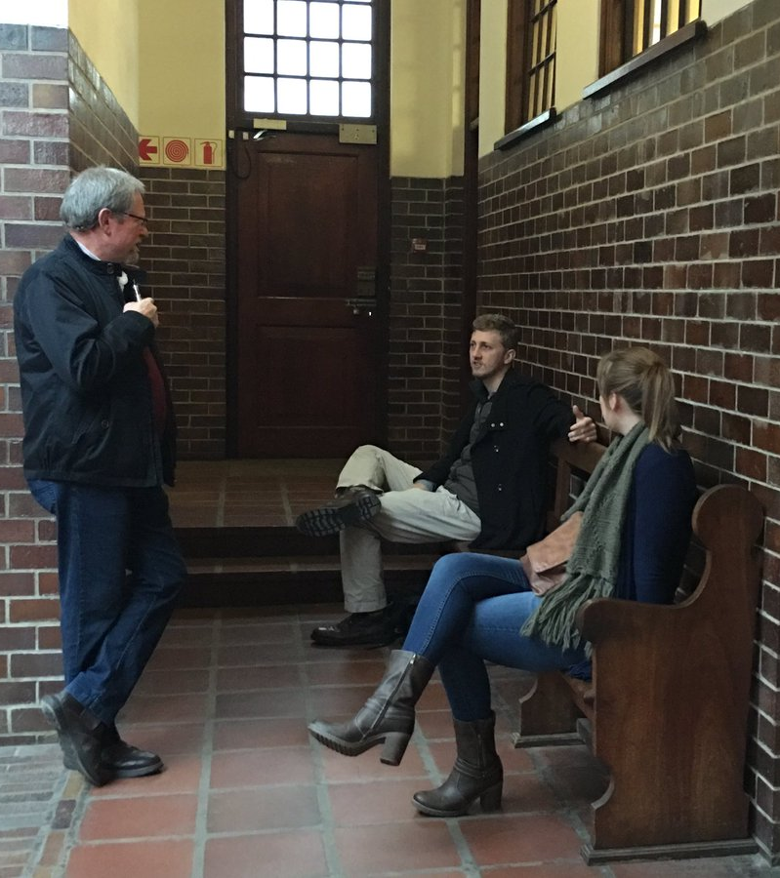
Agency Policy If Advocate Excluded From A Process

Slide 20
Agency Policy If Advocate Excluded From A Process
(ex: interview, exam)
Policy: It is the policy of Stand Up Placer to accompany survivors court proceedings, law enforcement interviews and forensic exams upon request.
If the advocate is excluded from a process (ex: interview, exam), the advocate will abide and stay at the location until interview/exam is completed and be available for the client when process is concluded.

