Slide 1
Adverse Childhood Experiences
(ACEs)
Content courtesy of numberstory.org

Slide 2
What Are ACEs?
ACEs are Adverse Childhood Experiences.
Our ACE history counts experiences of abuse, neglect and household challenges that happened to us as children.
But that number does not define us.
It is simply an entry point to our own personal story.

Slide 3

What Is A Number Story? (1min 30 sec)

Slide 4
Adverse Childhood Experiences (ACEs) can be highly stressful experiences that can happen to any of us before we turn 18.
ACEs are not our fault, and we didn’t have control over when or why they happened.
They can be a single event.
Or they can be an ongoing struggle where our safety, security, trust, or even our very sense of self is threatened or violated.

Slide 5
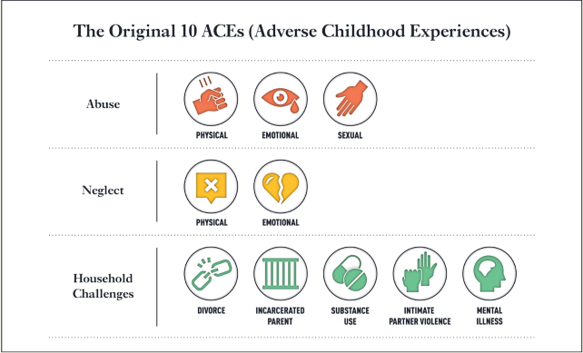
The term Adverse Childhood Experiences – or “ACEs” – comes from an important study published by the CDC and Kaiser Permanente in 1997.
It looked at ten types of stressful or traumatic events that fall into three categories:
Abuse: Encompasses physical, sexual and emotional abuse.
Neglect: Encompasses physical and emotional neglect.
Household Challenges: Growing up in a household with incarceration, mental illness, substance use, parental separation or divorce, or intimate partner violence.

Slide 6
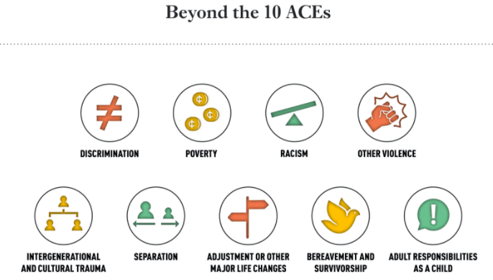
As many of us know, these 10 ACEs are not the only kind of adversities we may face as children.
Millions of us have experienced discrimination, poverty, and racism as kids, and these experiences can have similar impacts as ACEs.
Discrimination based on race, ethnicity, gender identity or sexual orientation (such as LGBTQ+), religion, learning differences, or disabilities
Poverty
Racism, systemic and institutional
Other violence, like getting bullied, experiencing violence yourself, or seeing others get hurt in your neighborhood, community or school
Intergenerational and cultural trauma, like the displacement and genocide of indigenous people, slavery, and the Holocaust
Separation from a parent or caregiver because of immigration or foster care
Other big changes in life, like immigration, being a refugee or seeking asylum, moving to a new area where you don’t know anyone, or separation from someone important to you
Bereavement and survivorship, like having a relative or caregiver die, or surviving an illness, injury or accident, or natural disaster
Adult responsibilities as a child, like caring for someone who’s sick or disabled, or being the one responsible for getting food on the table at a young age

Slide 7

Oprah Winfrey discuss Adverse Childhood Experiences (ACEs) for Numberstory.org (16 min)

Slide 8



Putting It All Together

Slide 9

Self-Awareness Reminders
Do not impose your own values.
  This does not mean you cannot express concern about a person’s choices if you believe they are in danger. It does mean you must be careful not to reject them even if you disagree with their choices.
Minimize educational, social and economic differences as much as possible.
  Keep the discussion to their life and generally, answer their questions about your life to an appropriate minimum. Always convey warmth, respect and concern.
Be aware of your attitudes, experiences, and reactions to violence.
  Be in tune with how violence has impacted your own life.
Be able to tolerate your own anger and the survivor’s anger.
  If needed, have some personal outlets for your anger, anxiety and frustrations. See support and gain the ability to attach/detach.
Know your own limits of time and energy.
  Set boundaries for yourself and set time just for yourself.
Be aware of your agency’s policies and services.
  This will allow you to be realistic with the survivor.

Slide 10
Stages of Peer Counseling
Initial Stage
Ask who you are talking to…some may want to remain anonymous.
Ask if they are SAFE and is it OK to talk.
Ask if they need medical attention or law enforcement.
Ask if their abuser is present, coming back or has weapons.
Open The Conversation
Examples: Thank you for calling…that took a lot of courage.
How can I help you right now? What’s going on for you?
When appropriate, ask about family or friend support.
Listen.
Planning Stage
What is their major concern?
Let them know about CBV services.
Wrapping It Up
When the conversation is done, summarize briefly – especially if you provided referrals.
Reinforce their safety plan (if applicable).
Check in on feelings.
Shelter?
Restraining order?
Other services?
Encourage them to come into the CBV office to meet with an advocate.

