Slide 1

Boundaries for client and advocate safety

Slide 2

Why boundaries matter
Boundaries are essential in relationships between advocates and survivors of domestic violence, sexual assault and human sex trafficking.
They protect the survivor’s autonomy, safety, and healing while also ensuring advocates provide ethical, sustainable support.

Slide 3
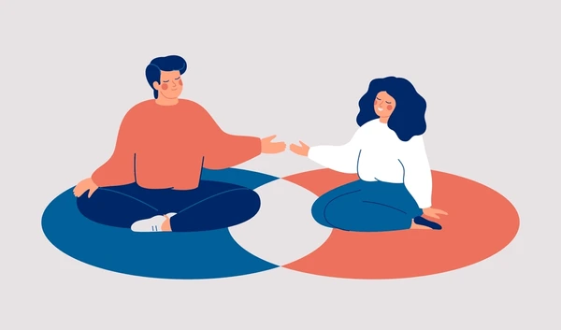
Why boundaries matter
Survivors often come from environments where boundaries were ignored or violated.
Clear limits help rebuild control, trust, and safety.
Advocates avoid burnout, over-involvement, or unintentionally causing harm.

Slide 4

BOUNDARIES FOR ADVOCATES
Professional Role Boundaries
You are a support person, not a rescuer, savior, or decision-maker
Avoid taking control of the survivor’s choices.
Do not provide services outside your training (e.g., legal or medical advice).
Emotional Boundaries
Show empathy without absorbing the survivor’s trauma.
Avoid becoming the survivor’s only emotional support system.
Be mindful of vicarious trauma and compassion fatigue.
Physical & Personal Boundaries
Limit physical contact unless clearly appropriate and consented.
Do not share personal contact info, social media access or meet in private/non-professional settings.
Confidentiality Boundaries
Explain confidentiality clearly (including limits like mandatory reporting if providing childcare or assisting in the Safe House).
Power & Ethics
Be aware of power dynamics.
Avoid dual relationships (friendship, financial involvement, romantic/sexual contact — always inappropriate).

Slide 5

BOUNDARIES FOR SURVIVORS
Choice & Autonomy –
Survivors have the right to:
Make their own decisions (even if others disagree)
Change their mind
Say “no” at any point
Emotional Boundaries –
Survivors can choose:
What to share and what not to
When to talk about trauma
Who they trust
Physical & Safety Boundaries
Right to personal space and bodily autonomy
Right to set limits on contact with others (including the abuser)
Boundaries with Advocates
Can ask for a different advocate
Can stop services at any time
Can give feedback if something feels uncomfortable
Communication Boundaries
Can decide how and when to communicate
Can ignore calls/messages that feel unsafe or overwhelming

Slide 6

Shared boundaries – advocate + survivor
Mutual Respect
Clear Expectations about roles and limits.
Consent-based Interaction (especially in discussions of trauma).
Transparency and honesty about what can and cannot be done.

Slide 7
COMMON BOUNDARY CHALLENGES
Survivors may test boundaries (often due to past violations).
Advocates may feel pressure to “do more” than is appropriate.
Crisis situations can blur roles.
Emotional attachment can develop on either side.

Slide 8

HEALTHY BOUNDARY PRACTICES
Use clear, compassionate language
“I care about your safety, and I can’t be available overnight, but here’s a 24/7 crisis line.”
Safety planning with survivor input.
Regular check-ins with other advocates and staff.
Ongoing consent check-ins with survivors.

Slide 9
CORE PRINCIPLES TO REMEMBER
Boundaries are not barriers - they are tools for safety, empowerment, and healing.
For survivors, they rebuild control.
For advocates, they ensure support remains ethical and sustainable.
SURVIVOR AUTONOMY COMES FIRST
YOU ARE SUPPORT, NOT SAVIOR
BOUNDARIES = SAFETY (FOR BOTH OF YOU)
CLARITY IS KINDNESS

Slide 10
SCENARIOS
📌 Scenario 1: Survivor Wants You to Make Decisions
Situation:
A survivor says: “Just tell me what to do. Should I leave?”
Risk:
Removing survivor autonomy, creating dependency
Effective Response Script:
“I hear how overwhelming this feels. I can’t make that decision for you, but I can help you think through your options and what feels safest for you.”
Why this works:
Centers survivor choice
Provides support without control
📌 Scenario 2: Survivor Wants a Personal Relationship
Situation:
They say: “You’re the only one who understands me. Can we be friends?”
Risk:
Dual relationship, ethical violation
Effective Response Script:
“I’m really honored you feel safe with me. My role is to support you as your advocate, and I want to keep that space focused on you and your needs.”
Why this works:
Affirms connection
Maintains professional boundary

Slide 11
SCENARIOS
📌 Scenario 4: Advocate Feels Overwhelmed or Emotionally Invested
Situation:
You’re thinking about the survivor constantly or feel responsible for their outcomes
Risk:
Burnout, boundary erosion
Internal Boundary Script (Self-talk):
“I can care deeply without carrying this alone. My role is to support, not to fix.”
Action Steps:
Seek peer support
Take breaks when needed
Reconnect with role boundaries
📌 Scenario 5: Survivor Rejects Your Suggestions
Situation:
They decline safety planning or resources
Risk:
Advocate frustration, overstepping
Effective Response Script:
“That’s completely your choice. If you ever want to revisit options or talk through anything, I’m here.”
Why this works:
Respects autonomy
Keeps door open

Slide 12
ROLE PLAY PROMPT
One person plays the survivor, one the advocate.
Survivor Says:
“I don’t trust anyone else. I only want to talk to you.”
Advocate Response:
Practice validating feelings while maintaining boundaries.

