Slide 1
Trauma-Informed Support for CSEC & HT Survivors

Slide 2
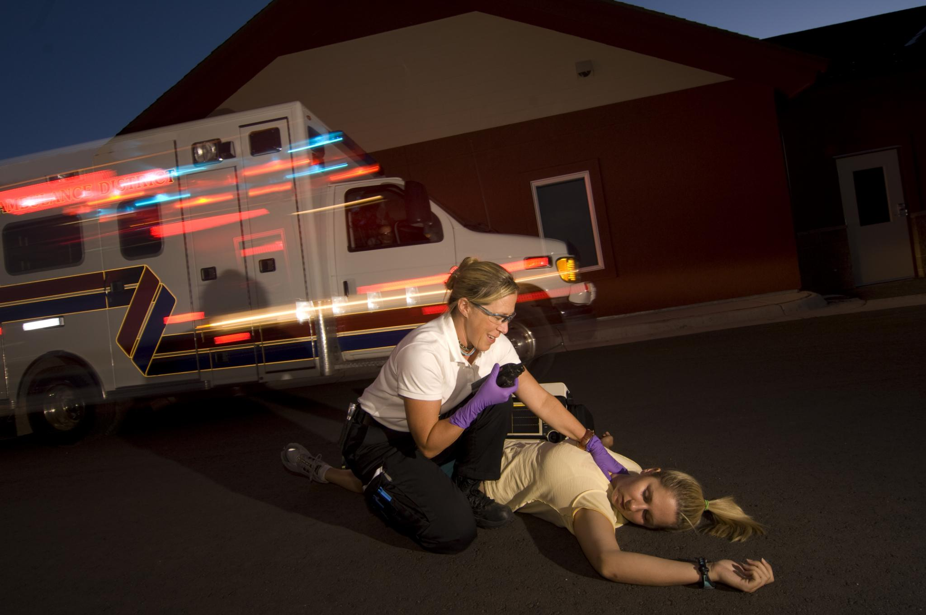
Understanding Survivor Responses
Misunderstood Survivor Behavior
  Survivors may appear resistant or hostile due to fear and self-preservation, not defiance or non-cooperation.
Survival Not Resistance
  Behaviors are survival mechanisms, often linked to fear of retaliation or normalized exploitation.
Trauma-Informed Engagement
  Understanding survivor behavior through trauma-informed approaches promotes trust, safety, and reduces power struggles.
Ethical, Compassionate Decision-Making
  Trauma awareness in advocates reduces frustration and leads to ethical, compassionate responses in the field.

Slide 3

Building Trust
Gradual Trust Building
  Trust develops over time through authenticity, consistency, and respecting survivors' realities without imposing expectations.
Safe and Respectful Environment
  Creating a safe space physically and emotionally is crucial for open communication on sensitive topics.
Empowering Communication
  Using non-clinical language reduces power imbalance and gives survivors control over sharing their experiences.
Trust Through Human Connection
  Trust is built through genuine connection, reliability, and respect for personal boundaries, not authority alone.

Slide 4

Building Trust: Key Actions
Honesty and Transparency
  Being honest and transparent helps survivors feel grounded and reduces confusion or false hope.
Listening Over Speaking
  Listening more than speaking allows survivors to guide the interaction and feel valued.
Empowerment vs Rescue
  Emphasizing empowerment respects autonomy and supports survivors' decision-making capacity.
Consistency and Follow-Through
  Consistency and doing what you say builds reliability and integrity in relationships.

Slide 5

What not to do
Don't interrogate​
Don't confront​
Don't label​
Don't rush rescue​

Slide 6

Critical Reminders for Advocates
Survivor-Centered Approach
  Survivors are never at fault for exploitation and should never be treated as criminals.
Trust and Boundaries
  Trafficking violates trust and autonomy, requiring time to rebuild relationships with survivors.
Emotional Validation
  Validating emotions helps reduce shame and supports survivors’ emotional regulation.
Hope and Patience
  Healing is nonlinear; responders should remain patient and hopeful throughout recovery.

Slide 7

Your role as an advocate
Ensure safety​
Build rapport​
Connect to services​
Stay trauma-informed​

Slide 8

Self-awareness for advocates
This work is hard​
Use support systems​
Stay professional​

Slide 9

Language and Professional Self-Awareness
Survivor-Centered Language
  Using survivor-centered language builds trust and avoids triggering defensiveness or emotional harm.
Focusing on Safety and Support
  Responders should prioritize safety and support rather than challenging survivor terminology too early.
Managing Emotional Toll
  Professionals need supervision, peer support, or counseling to manage the emotional challenges of this work.
Maintaining Professional Boundaries
  Maintaining boundaries protects both responder and survivor, preventing emotional responsibility overlap.

Slide 10

REMINDER
Don't push disclosure​
Don't argue​
Don't promise outcomes​
Don't take it personally​

Slide 11

Suggested Approach with HT survivors
This Photo by Unknown Author is licensed under CC BY-NC-ND
Stay calm​
Avoid labels​
Focus on safety​
Offer resources​

Slide 12

Immediate Needs and Comprehensive Services
Specialized Advocacy Support
  Advocacy guides survivors through complex systems, empowering informed decisions and access to needed services.
Trauma-Informed Therapy
  Therapy focuses on emotional healing using strengths-based, trauma-informed approaches respecting survivor experiences.
Medical and Psychological Care
  Comprehensive evaluations address both visible and hidden trauma impacts to facilitate holistic recovery.
Safety and Legal Assistance
  Safety planning and legal aid help reduce risk and empower survivors to understand their rights.

Slide 13

Local Resources and Ongoing Support
Local Support Organizations
  Organizations like Stand Up Placer, Children’s System of Care, and KidsFirst provide immediate assistance and referral services.
Accessible Contact Information
  Providing crisis lines, office numbers, emails, and websites enhances accessibility and reduces barriers to seeking help.
Collaborative Survivor Support
  Effective trauma-informed response relies on strong partnerships and informed referrals beyond single agencies.
Empowering Responders
  Familiarity with local resources enables responders to act quickly and confidently during critical opportunities.

Slide 14

Key Takeaways
Behavior = survival​
Trust takes time​
Language matters​
Connection matters​

Slide 15
You may not change today—but you change what happens next​

Slide 16
Resources
Stand Up Placer
Roseville Service Office: 916-773-7273
24-hr-crisis line: 800-575-5352
vickie@standupplacer.org
KidsFirst
916-774-6802
National Human Trafficking Hotline
888-373-7888

