Slide 1

Placer County District Attorney Family Protection Unit
10810 Justice Center Drive, #240
Roseville, CA 95678
MORGAN GIRE
District Attorney

Slide 2

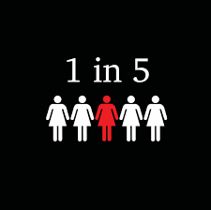
Murder Prevention
1 in 5 homicide victims are killed by an intimate partner (source: CDC)
On average, more than 3 women a day are murdered by boyfriends/husbands a day in the U.S. (source: US Dept. of Justice, Bureau of Justice Statistics)
Over half of female homicide victims in the U.S. are killed by a current or former intimate partner (source: CDC)
Firearms significantly contribute to the fatality – Abusers with guns are 5x more likely to kill their victims
1 in 4 U.S. women experience violence by a partner at some point in her life.

Slide 3
DOMESTIC VIOLENCE (IPV) and CHILD ABUSE
DEDICATED DDAs
VERTICAL PROSECUTION: MISDEMEANOR & FELONY
PC 273.8: “vertical prosecution = a proven way of demonstrably increasing the likelihood of convicting spousal abusers and ensuring appropriate sentences for those offenders.”
DEDICATED COURTROOM
Honorable Judge DeJesus

Slide 4
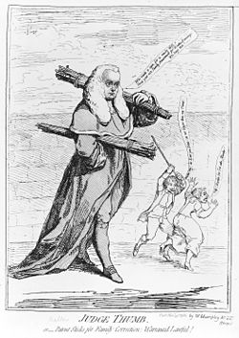
1970’s Movement
Rule of Thumb
During the Battered Women’s Movement of the 1970s, activists pressed for IPV to be prosecuted as a violent crime like any other. This approach yielded state mandatory arrest and prosecution laws which removed discretion from police and prosecutors. States also implemented orders of protection (or restraining orders) that were intended to provide victims a civil court remedy.
Federal lawmakers followed suit in 1994 with passage of the Violence Against Women Act (VAWA), which among other provisions, funded law enforcement, prosecutors and courts to combat domestic violence
Evidence Code Section 1109 “Propensity Evidence”– Prior IPV within 10 years. (EC Section 1108 - Sex Offense mirror)

Slide 5
Placer County Cases
Comprised of IPV and Child Abuse
Approximately 2,000-2,500 cases rvwd a year
Two court days a week devoted to DV cases with approximately 100 cases on each Cal.
6 Assigned DDAs, 4 victim advocates, special assigned DAI, special assigned Stand-Up Placer Advocate

Slide 6
FILING
In-Custody
Bail to Appear
Referrals
FC 1203.097 Terms
- Special Probation Terms
- Mandatory Treatment Programs
* Batter’s Treatment Program (BTP)
* Parenting Treatment Program (PTP)
*104 Hrs Specific Counseling

Slide 7
Domestic Violence Crimes
Murder
Attempted Murder
Infliction of Injury on Spouse/dating partner/parent of child, etc.
Battery on spouse/dating partner/parent of child (no injury)
Kidnapping/False Imprisonment
Rape/Spousal Rape
Criminal Threats
Strangulation
Restraining Order Violations (DVRO v. CPO)
Harassing Phone Calls/Burglary/Trespass
Stalking
Dissuading
Vandalism

Slide 8
The Domestic Violence Investigation
Witness statements
Medical
Records
Suspect statement
Victim statement
CASE
911 call
Photo or video
Prior arrests/CPS history
Child Interviews
Cell Phones
Search Warrant

Slide 9
Burden of Proof
Arrest
  Police Standard: Probable cause
    50.1%--more likely than not
Filing guidelines
  DA Standard: Reasonable likelihood of conviction
    Jurisdiction
    Statute of Limitations
Preliminary Hearing
  Probable cause for the charges filed
Trial
  Beyond a Reasonable Doubt – Requires ALL 12

Slide 10
CHALLENGES IN DOMESTIC VIOLENCE CASES – FILING?
CHALLENGES
  - V uncooperative
  - No injury
  - Self defense claim cannot be disproven (pushing)
  No Witness
  Late reporting
PROOF…
  - Statements made contemporaneous with description of injury
  Statements made when under the excitement of an event (911)
  Documentation Injury
- Electronic documentation (Phone, video, Ring)

Slide 11
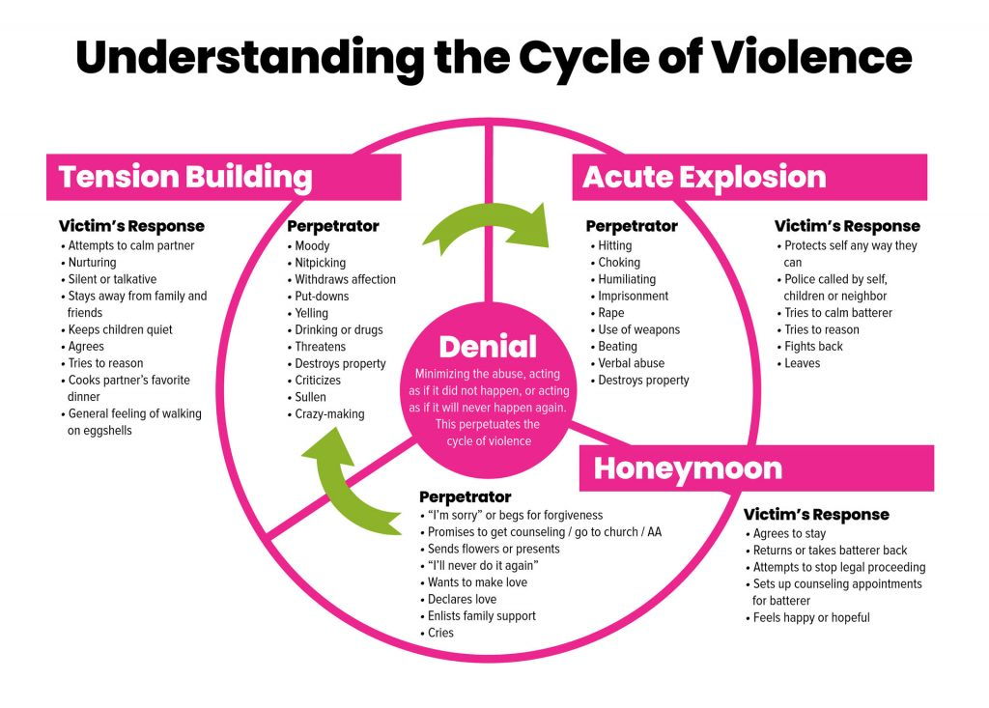

Slide 12
Recanting - Victim’s Reality
FEAR
- Retaliation
- Children/family member harm or loss (CPS)
- Loss of community or family support
- Isolation
- Will not be Believed
- Justice System will not help/be able to stop abuse
- Financial
Shame/Guilt

Slide 13
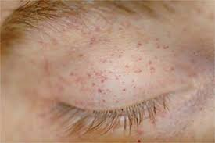
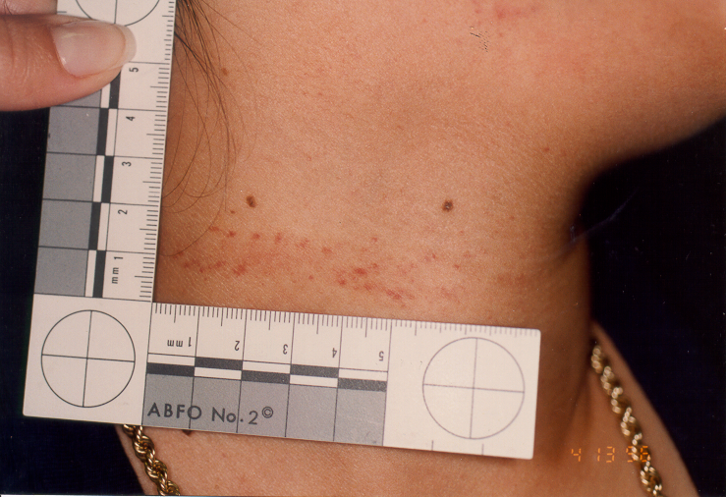
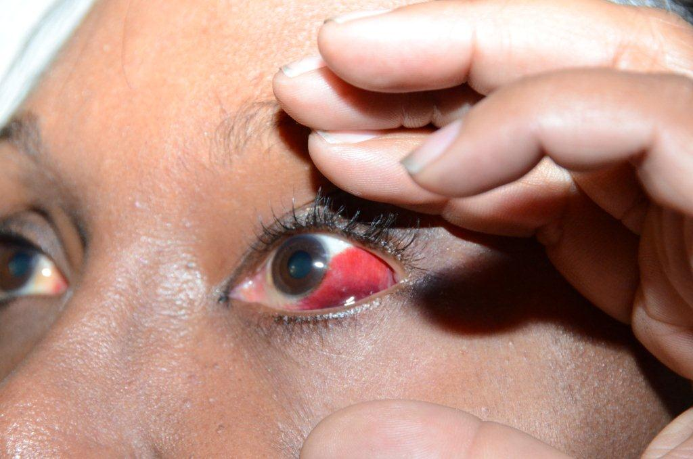
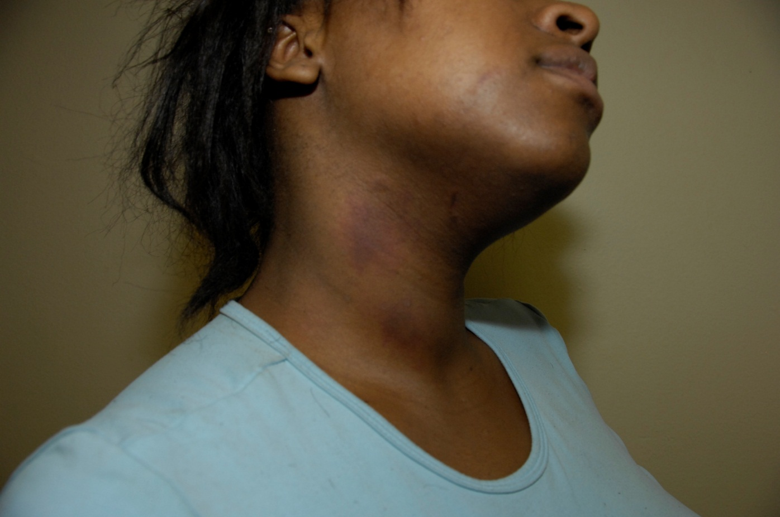
Strangulation - One of Most Lethal Forms IPV

Slide 14
Applicable Force
4.4 Pounds of Force to Compress Jugular Vein
11 Pounds of Force to Compress the Carotid Artery
33 Pounds of Force to Compress the Trachea
18-66 Pounds of Force to Compress the Vertebral Arteries
**80-100 Pounds of Force = Average Adult Male Firm Handshake

Slide 15
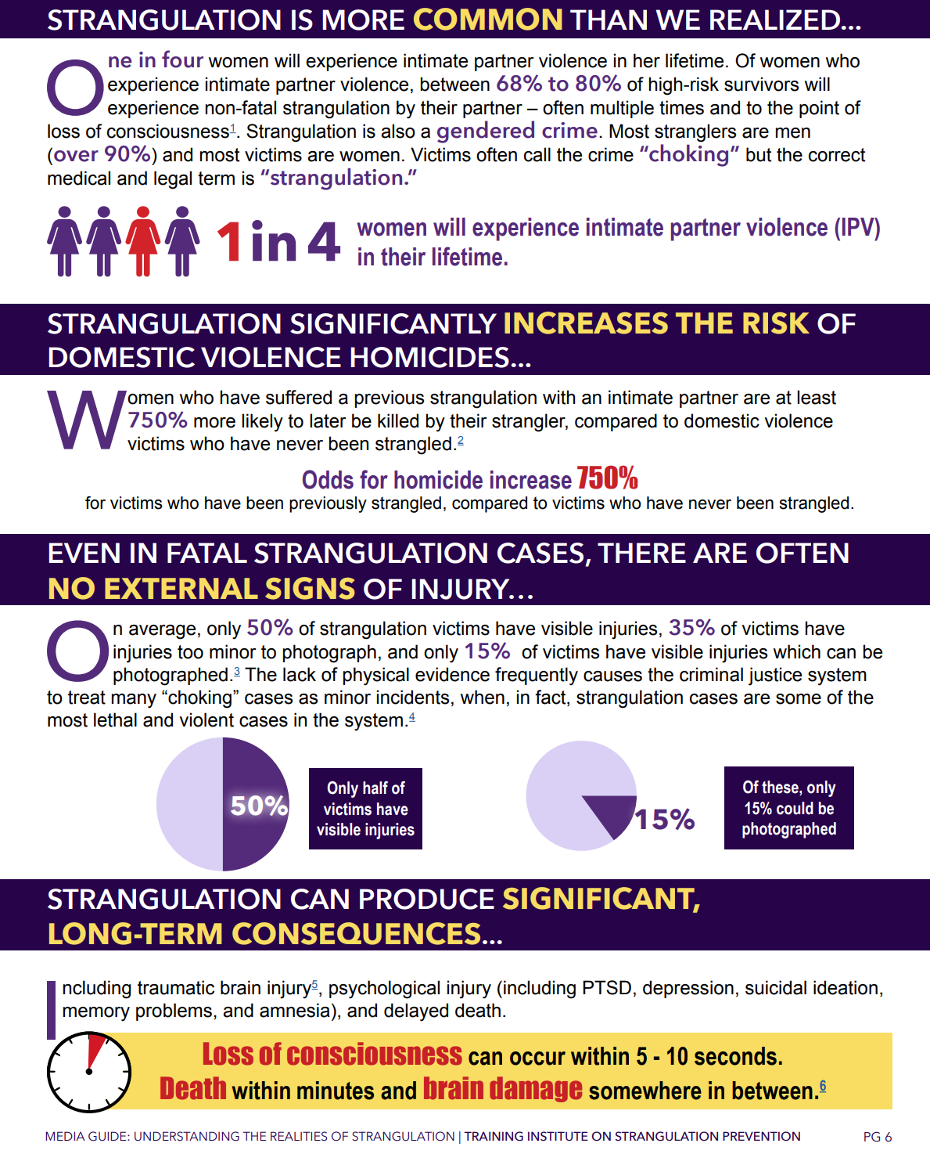

Slide 16
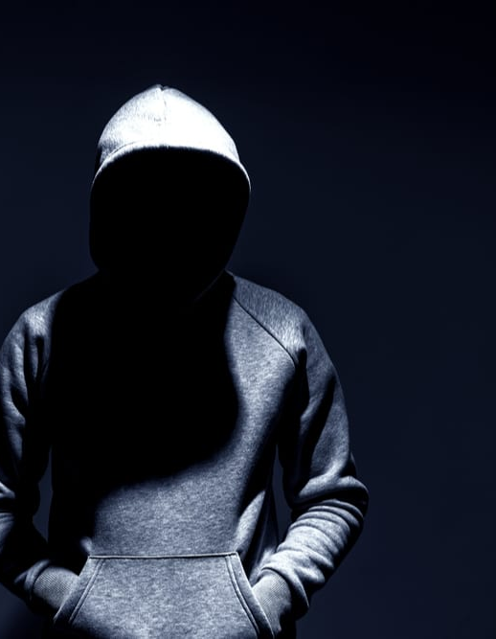
Stalking & Lethality
1 in 12 women and 1 in 5 men have been stalking victims
Most stalking victims know each other
Majority of women stalked reported previous IPV in the relationship with stalker (81%)
Approx. 40% stalked experienced threats of harm
Stalking increases the risk of homicide by 3x
IPV Homicide/Femicide – approx. 90% femicide victims who had been physically abused during the relationship had also been stalked

Slide 17
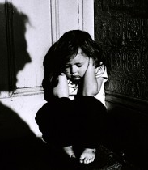
The Lost Victims

Slide 18
IPV - Impacts on Children
More likely to be victims of child abuse
Increased risk for behavioral problems
Impacts to Neurological development (Toxic Stress)
Potential for increased irritability, sleep problems, emotional distress
Potential impact on academic success
Greater risk for substance abuse, juvenile pregnancy and criminal behavior

Slide 19

Domestic Violence Interviews (MDIC)
Remember a lot of events that the victim may have forgotten or thought the children didn’t hear/know about
  1109 evidence and/or new charges
Establish the tone/environment of the home
Helps overcome the anticipated DV recant
Helps overcome self-defense claims
Generally know about weapons in the home
Have tried to stop fights
Lost victim

Slide 20
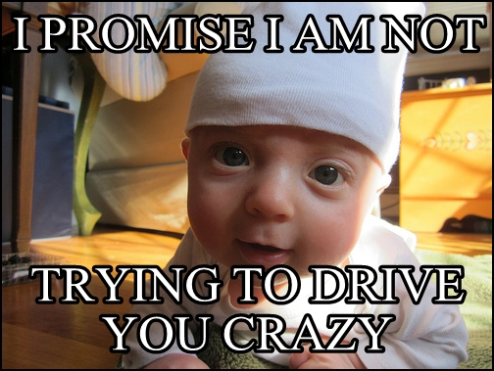
Child Abuse

Slide 21
Types of Child Abuse
Physical abuse
Sexual abuse
Abusive Head Trauma
Neglect
Drug Endangered Children
DUI with children inside vehicle

Slide 22
Consequences
If a person is convicted of violating this section and probation is granted, the court shall require a minimum period of probation of 48 months
52 weeks of mandatory counseling
If alcohol or drugs involved defendant required to submit to random testing

Slide 23
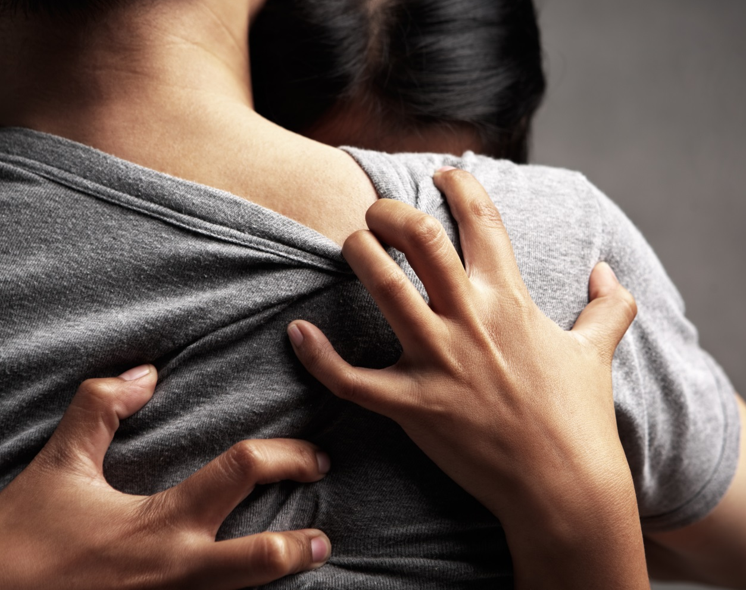
The Decision to Resolve a Case

Slide 24
Case Resolution – Factors We Consider
Strength of the Case
- Victim Support
- Corroboration
- Admissions/Confessions
- Documentation
- Any admissibility issue
Victim Feelings
Defendant’s Record
Sentencing exposure
290 Registration
Prior able convictions
Injuries
  - Extent
  - Medical records
  - photos
Witness cooperation
Victim and Witness records
Maximum sentence and minimum sentence
Restitution
Community Safety

