Slide 1
Introduction and History of Sexual Violence,
Types and Definitions of Sexual Assault
Presented by: Emalee Beavers, SART Coordinator

Slide 2
Goals for Today:
Define Sexual Assault and Sexual Violence
Deeper look at how SA/SV works as a system
History of the Movement
Consent
Impact/Psychology of SA/SV
How We Prevent
Notes:
Define key terms and expand education surrounding sexual violence
Convey the importance of the topic
Sexual violence as a public health, human rights, and social justice issue
Gain understanding of early history of the movement, and where we are at now
I may use victim/survivor interchangeably

Slide 3
Reflection:
What brought me to this conversation today?
What do I hope to better understand by the end?
What do people need to feel safe engaging in this topic?

Slide 4
Defining Sexual Assault and Sexual Violence

Slide 5
Sexual Violence vs Sexual Assault
Umbrella term
  Any sexual act or behavior committed without freely given consent
    Sexual Assault
    Sexual Abuse
    Sexual Harassment
Advocates support survivors’ self-definitions of their experiences
We don’t rank survivors’ experiences
Notes:
Sexual Assault- Includes any unwanted contact, ranging from unwanted touching, kissing, to penetration
Sexual abuse- takes place when a person knowingly causes another person to engage in a sex act by threatening or placing the other person in fear, or if someone engages in a sexual act with a person who is incapable of appraising the nature of the act or unable to give consent.
Sexual harassment- includes unwelcome sexual advances, requests for sexual favors, and other verbal or physical harassment of a sexual nature.
focus less on labeling and
more on listening and providing support,
Do we all know what trauma is? A traumainformed approach means that we recognize that we all have different lived experiences shaped by a variety of factors. The degree of harm that someone experiences and lasting effects of sexual violence have less to do with the specific form of sexual violence and more about a person’s experience.

Slide 6
Definition Of Sexual Assault​
Sexual violence or sexual assault is any act of a sexual nature perpetrated without consent.
California Penal Code §261 defines sexual assault to include a variety of nonconsensual behaviors such as sexual harassment, sexual touching, and rape (defined as nonconsensual penetration).
An essential element to under­standing sexual assault is recognizing it as an act of violence.
It is not an act of sex, sexual desire, or a crime of passion - terms and phrases you may have heard on television and from people in your life.
It is also not an accident or a behavior over which the perpetrator has no control.
But because it happens within a sexual context, many continue to confuse this act of violence, and abuse of power and control with “bad sex.”
Notes:
Starting “easy”

Slide 7
Definition Of Sexual Assault
When viewed at the societal level
  sexual violence functions to maintain unequal human relations primarily based on gender and other iden­tities (race, sexual orientation, etc.), with women historically having experienced the greatest level of sexual violence
Sexual violence is a choice where the perpetrator asserts their interests over another’s right
  to safety and security of their own body, illegally exerts power and control over another person, and violates an individual’s sense of self with life-changing consequences
“Gendered Vio­lence,”
  which includes sexual violence, intimate partner violence, and stalking. This term acknowl­edges men are most often the perpetrators of sexual violence irrespective of the gender or sexual identity of the victim or survivor
Mi­sogyny
  (hatred of women) engender dominance and entitlement within a system of patriarchal masculinity, which considers men to be in charge
Sexism
  (which is prejudice and discrimination based on sex)
This is the background from which sexual violence emerges
Sexual violence affects individuals of all genders, abilities, socioeconomic statuses, racial identities, and ethnicities

Slide 8
Spectrum of Sexual Violence
Accessibility
Vulnerability
Credibility
Risk factors:
  Individual
  Relationship
  Community
  Societal
Notes:
The spectrum of SV can use accessibility to the victim/survivor, vulnerability of the victim survivor, and credibility of the victim/survivor to perpetrate harm. There are also risk factors that and increase
Individual: substance use, history (prior victimization)
Relational: peer groups, family violence/poor supervision, social dynamics
Community/societal: demographics (women, young adult) context (high crime rates), social settings (alcohol consumption)

Slide 9
Quick Poll
When people hear “sexual assault”, what do they usually picture?
Who or What gets left out of that picture?
Notes:
10-15 mins

Slide 10
Context in Which Assault Occurs
Acquaintance vs. stranger
Dating and relationships
Institutional settings
Online or technology‑facilitated abuse

Slide 11
Examples of Sexual Violence
• Being too drunk or intoxicated to give consent
• Not being of mental capacity to give consent
• Sexual assault of people who are incarcerated or in police or immigration custody
• A coach sexually abusing a player during away games
• A graduate assistant telling a student they will only pass if they have sex with them
• Unwanted sexual comments or advances while running in the park
• Sexual abuse by a priest or other spiritual leader
• Sexual harassment by a boss or co-worker
• Being groped by a stranger on mass transit
• Someone exposing themselves to another person at a party without consent
Notes:
“Sexual violence means that someone forces or
manipulates someone else into unwanted sexual activity without their consent. Reasons
someone might not consent include fear, age, illness, disability, and/or influence of
alcohol or other drugs. Anyone can experience sexual violence including: children, teens,
adults, and elders. Those who sexually abuse can be acquaintances, family members,
trusted individuals or strangers” (NSVRC, 2010).

Slide 12
• Targeting trans individuals with sexual violence as an attempt to degrade them
• Threatening to evict unless a tenant has sex with them
• Sharing nude photographs of someone without consent
• A boss sexually assaulting a farmworker who is undocumented and does not speak English
• Videoing sexual acts without consent
• A nurse at a personal care home sexually assaulting a resident who is bedridden

Slide 13
• When someone sends unwanted photos of their genitals
• Forcing someone to have photos taken of their naked body
• Forced viewing of pornography
• Watching someone disrobe or have sex when they have not given permission
• Hidden cameras in bathrooms or dressing rooms
• Being forced by a partner or spouse to have sex
• Receiving unwanted sexually explicit messages
• A mentor using their influence over a mentee to coerce them into sex

Slide 14
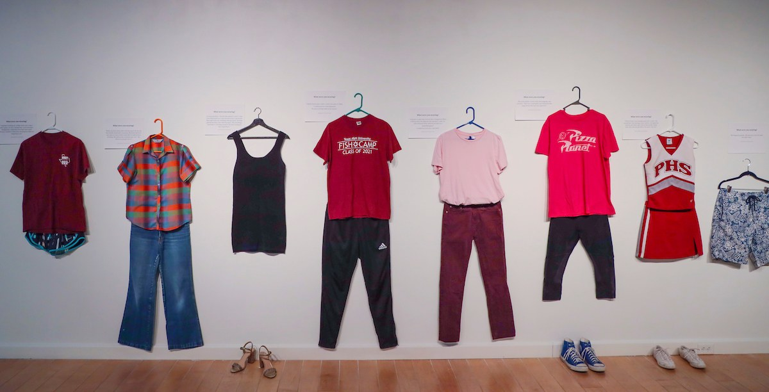
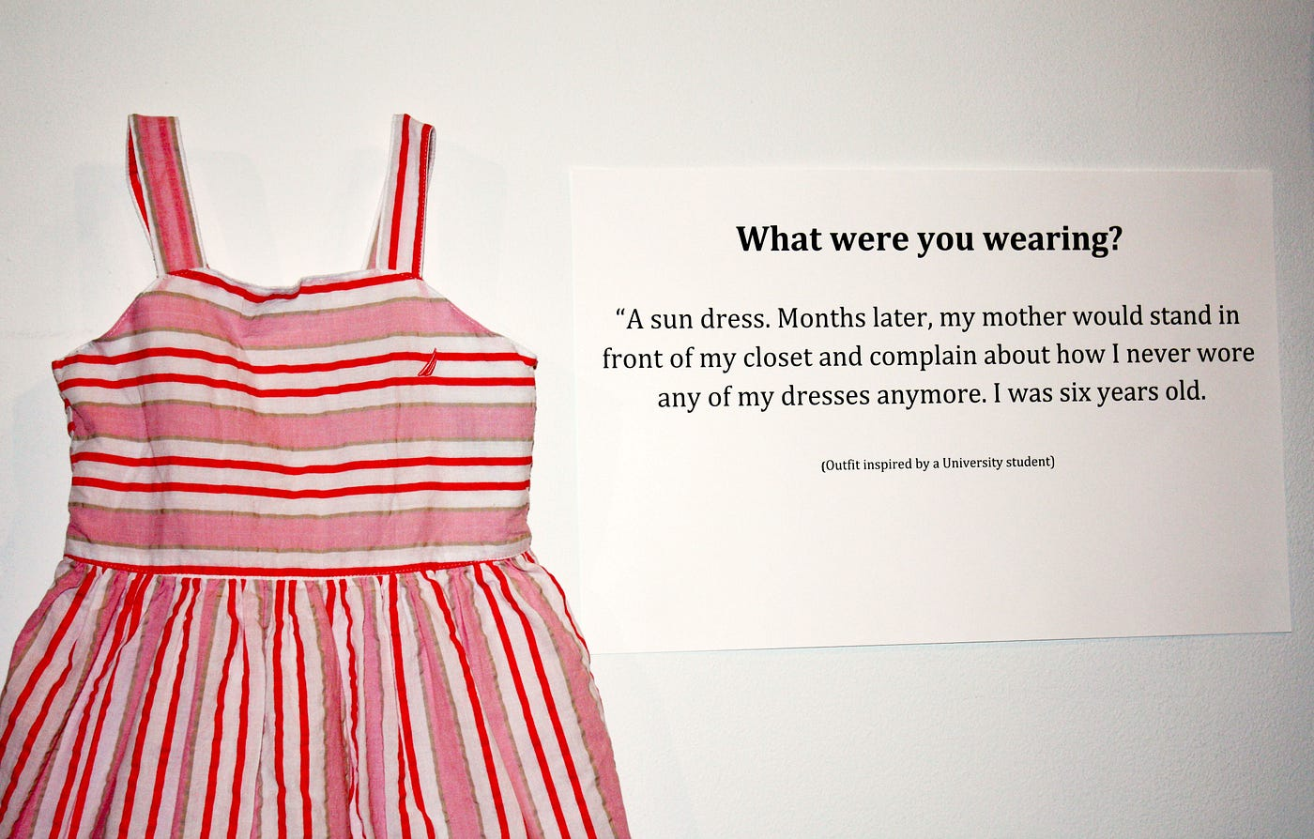
What Sexual Assault Is Not
Not caused by clothing, alcohol use, or behavior
Not a misunderstanding
Not always violent or obvious

Slide 15
How SA/SV Works As a System

Slide 16
How Does SA/SV Work as A System?
Power + Social Norms + Silence + Weak Accountability = Ongoing Sexual Violence
Produced, maintained, and normalized through interconnected social, cultural, legal, and institutional structures, not just individual bad actors.
  The foundation: Power Dynamics, how people are socialized
  Cultural narratives that normalize: media, jokes, myths
  Silence and disbelief: institutional
Notes:
Power dynamics: Gender norms and patriarchy, Age and authority, Race and colonial history, Disability and dependency, Economic vulnerability, Immigration and legal status
Socialized: Entitlement to bodies or attention Silence and compliance as “politeness” Masculinity tied to dominance or conquest Femininity tied to accommodation and risk management
Silence and disbelief: Fear of not being believed
Fear of retaliation or social fallout
Shame internalized from cultural messages
Past experiences of being dismissed
Systemic consequences (custody, housing, immigration, employment)

Slide 17
So, How Did We Get Here?
History of the Movement

Slide 18
History of the Anti Rape movement
1848- Seneca Falls Convention: First Women's Rights Convention
“all men and women are created equal”
Women's suffrage
1892- Ida B Wells investigated the causes of lynching
"Is Rape the 'Cause' of Lynching?”
Dismantling the justification that lynching was a reaction to the sexual assault of white women by Black men
1890’s- formation of the Black Women’s Club movement, laid the groundwork for the later establishment of several national organizations, such as the National Coalition Against Domestic Violence.
Notes:
Feminism is heavily intertwined with the anti rape movement and anti racism movement
1848: Elizabeth Cady Stanton, Lucretia Mott, over 300 people in attendance
1892: Wells challenged the "old thread-bare lie" that rape was the primary cause of lynching, arguing that it was a myth used to justify racial terrorism

Slide 19
1970s Second-Wave Feminist Movement: consciousness-raising groups where women shared experiences, recognizing rape as a political and social problem, not just individual crime.
1920- 19th Amendment Passed
Federal Legislation was passed giving women the right to vote in election and to own property
1940s- Rosa Parks worked with the NAACP to investigate cases of SA against Black women
1970s–1980s: Advocacy pushed for "rape shield" laws and criminalizing marital rape.
1984: The Victims of Crime Act (VOCA) was passed, providing federal funding for victim assistance.
Notes:
1920s: Between 1878, when the amendment was first introduced in Congress, and August 18, 1920, when it was ratified, champions of voting rights for women worked tirelessly
1940s: this includes the kidnapping and gang rape of Recy Taylor
1970s:
1971: The New York Radical Feminists held the first "speak-out" on rape.
1972: The first rape crisis centers were established, including the Bay Area Women Against Rape and Washington DC Rape Crisis Center.
1970s Activism: Activists, including groups like Philadelphia Women Organized Against Rape (WOAR), organized to support survivors and challenge patriarchal norms
1970-80s: (preventing victims' sexual history from being used against them in court)

Slide 20
RCC, Medical, and Criminal Centers Collaboration
RCC-Rape Crisis Center
Mission and Goal
  Effective, Competent, Coordinated intervention to ensure the best possible outcome for the survivors
Advantages
    This defines SA as a community problem
    Trauma-informed care using best practices and accountability

Slide 21
Why The SA/RCC movement is successful:
Focused on improving the treatment of survivors in the criminal and medical systems
Increasing public understanding of crime through educational programs
Initiating rape law reform to create fairness and justice
Implementing new standards of consent on college campuses

Slide 22
Title IX
landmark federal civil rights that prohibits sex discrimination in education
Does not apply to ONLY female students
Schools must be proactive in ensuring that their campus is free of sex discrimination
Schools must have established procedures for handling complaints of Sex discrimination, harassment, or violence,
Schools should ensure that a victim doesn’t have to share spaces, such as dorms, classes, or campus jobs, with their assailant
Schools may not retaliate against someone filing a complaint and must keep the victim safe from other retaliatory harassment or behavior
Schools can issue a no-contact directive to prevent the accused from approaching or interacting
Schools are prohibited from engaging or allowing mediation of the complaint
Schools can not discourage you from continuing your education

Slide 23
VAWA
The Violence Against Women Act (VAWA)
  A federal law (1994) that frames sexual violence and intimate partner violence as public safety and civil rights issues
  Protects people of all genders, despite the name
  Shifted violence from “private” to system responsibility
  Centered survivor choice, safety, and dignity
Laid the groundwork for SARTs, coordinated community response, and trauma‑informed practice

Slide 24
7 min break ☺

Slide 25
Advocacy Across Generations
3 categories:
  Early years (awareness)
  Growth phase (legislative changes, VAWA)
  Modern (intersectionality)
Advocacy to include services (empowerment, resources)
1980s
Digital activism enhancing outreach and awareness
2000s
1970s
Igniting a movement
1990s
Legislative changes (VAWA)
2020s
Intersectionality uniting diverse voices
Notes:
Explain VAWA
SA and AI- ai generated sexual imagery of women , children, men, etc

Slide 26
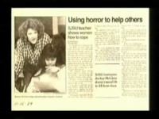

Slide 27
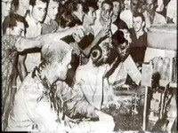

Slide 28
Consent

Slide 29
California enacted the ‘yes means yes’ affirmative consent law( SB 967) in 2014
This made CA the first state to enact a new consent standard for colleges and universities, in the hope of changing the culture of surviving sexual violence

Slide 30
What is Consent?
Consent is an agreement between participants to engage in sexual activity
  Consent should be clearly and freely communicated
  Can help both you and your partner to understand and respect each other’s boundaries
You can change your mind at any time and withdraw consent
Consent cannot be given by individuals who are underage, intoxicated or incapacitated by drugs or alcohol, or asleep or unconscious
  If someone agrees to an activity under pressure of intimidation or threat, that isn’t considered consent because it was not given freely
  Unequal power dynamics, such as engaging in sexual activity with an employee or student, also mean that consent cannot be freely given

Slide 31


Slide 32
What Does Consent Look Like?
Asking permission before you change the type or degree of sexual activity with phrases like “Is this OK?”
Confirming that there is reciprocal interest before initiating any physical touch
Letting your partner know that you can stop at any time
Periodically checking in with your partner, such as asking “Is this still okay?”
Providing positive feedback when you’re comfortable with an activity
Explicitly agreeing to certain activities, either by saying “yes” or another affirmative statement, like “I’m open to trying.”
Using physical cues to let the other person know you’re comfortable taking things to the next level

Slide 33
5 Min Break ☺

Slide 34
Psychology Behind Victims/survivors of Sexual Assault

Slide 35
Myths and Cultural Narratives
Examples:
“Real rape” looks a certain way
“False reports are common”
“Most assaults are by strangers”
“If it was serious, they would have reported”
“Alcohol makes it unclear who’s responsible”
Barriers to reporting, Victim‑blaming, Systemic harm

Slide 36
What were they doing when they were assaulted?
48% were sleeping, or performing another activity at home
29% were traveling to and from work or school or traveling to shop or run errands
12% were working
7% were attending school
5% were doing an unknown or other activity
All stats are provided by RAINN.

Slide 37
Survivors are 88% more likely to report to LE or seek out therapeutic services if the first person they tell believes them

Slide 38
The impact on survivors.
94% of female rape victims experience symptoms of PTSD within the first two weeks. 30% of those continue 9 months after.
33 % of female rape victims contemplated suicide, 13% of victims attempt.
3.4x more likely to use marijuana
6x more likely to use cocaine
10x more likely to use other major drugs

Slide 39
Survivors have reported:
Feeling
Isolated
Embarrassed
Ashamed
Responsible
Unsupported
Unworthy of help
Forced to drop out of school/ quit jobs or relocate

Slide 40
Cont.
Fear of being
Re-victimized
Triggered
Retaliated against by the perpetrator, peers, family, friends, and colleagues.
Blamed for their assault
Not believed
Forced to retell their story over and over
Mistreated by social services
Let down by the legal system

Slide 41
The closer the relationship, the less likely the Survivor will report the crime

Slide 42
Considerations For SA by Someone Known
It is common for survivors to not identify as victims right away when they know the perpetrator
They have an increased chance of being re-traumatized.
There is A LOT of complex emotions when you know the person
Victims can be afraid of not being believed or being blamed.

Slide 43
So, How Do We Prevent?
Primary Prevention
  Culture change
  Consent education
  Bystander intervention
Institutional Responsibility
  Policies, Training
  Accountability

Slide 44
How An Advocate Can Support Victims
Provide emotional support, peer counseling, crisis intervention, and advocacy to survivors of SA
Listen and empathize and reduce isolation of the experience
Supports and attempts to help survivor with their needs to the full ability of the advocate
Informs of options and rights following SA
Empower survivors to make their own decisions and supports them in it
Advocates with other parties- legal system, LE, within the agency, schools, medical providers, etc.
Provides appropriate boundaries and maintains survivors’ confidentiality

Slide 45
Medical and Legal Rights
Privacy and confidentiality
Decision on whether to report to LE
Access to a SART/forensic exam and rape crisis services for victims over the age of 12 (without parental consent)
Access to a VAWA exam
Having an advocate and support person present during legal or medical interventions
File a TRO for victims over the age of 12
Access to therapy for victims over the age of 12

Slide 46
Closing Prompts
Key Take Aways
  What is one idea from today that changed or expanded how you think about sexual violence?
  Did anything surprise you or stand out?
  What responsibility comes with having language that others may not yet have?

Slide 47
Resources
RAINN (Rape, Abuse & Incest National Network)
  Phone: 800‑656‑HOPE (4673)
  Online chat: online.rainn.org
National Sexual Violence Resource Center (NSVRC)
  nsvrc.org
StrongHearts Native Helpline
  844‑7NATIVE (762‑8483)
  Chat: strongheartshelpline.org
1in6Support for male survivors of sexual violence
  Website: 1in6.org

Slide 48
Thank YOU! Questions?
How are we feeling?
Share some self care

Slide 49
Emalee Beavers, SART Coordinator
Call me: 916-773-7273
Email me: emalee@standupplacer.org

