Slide 1


Protective Orders
What Is A Restraining Order?
Advocate Role & Restraining Order Support
Legal Advocacy
Types of Restraining Orders
Domestic Violence Restraining Order Criteria In Family Superior Court
Preparing the Orders
Domestic Violence Restraining Order Court Process
Volunteers In Court
Next Steps & Continued Support
Recantation Coercion

Slide 2

What Is A Restraining Order?

Slide 3
What Is A Restraining Order?
Court orders - clarifying basic civil rights
Protects individuals who have experienced interpersonal violence by a person whom they have had an intimate personal relationship with, are closely related to, have had a child with, or live or have lived with as more than just roommates.
Personal Conduct – “shall not harass, attack, strike, threaten, assault, hit, follow, stalk, molest, destroy personal property, disturb the peace, keep under surveillance or block movements”
Stay Away
Move Out Orders
Property Control (including animals)
Custody/Visitation
NO money issues will be addressed
No cost to file

Slide 4
Advocate Role & Restraining Order Support

Slide 5
Advocate Role & Restraining Order Support
Assist clients in obtaining safety
Provide Crisis Counseling
Listen & Support
Police Reports
Temporary Restraining Orders
Court Accompaniment
Mediation Accompaniment
Empowering client to advocate for themselves

Slide 6

Stand Up Placer Legal Advocacy
Advocates help client determine if a restraining order is appropriate and support them through the process.
Legal Department
  Provides legal information
  Preparation for court hearings and at times, representation
  Mediation preparation
Domestic Violence program team and certified volunteers provide accompaniment to court, law enforcement interviews, legal aid assistance and social services navigation.

Slide 7
Types of Restraining Orders

Slide 8
Types of Restraining Orders
Emergency Protective Order
Issued by Law Enforcement at the time of an incident
Good for 7 days
Criminal Protective Order
Issued by Court during the criminal process when perpetrator is released on OR or bail
Can be made a condition of sentencing or probation
BUT, may expire when case is closed.

Slide 9
Types of Restraining Orders
Domestic Violence Temporary Restraining Order
Must be based on domestic violence with a qualified relationship
Issued by the court – for a limited time, up to 21 days
FREE, no preparation, filing or service charges
Civil Harassment Temporary Restraining Order
Must be based on harmful behaviors or patterns of conduct
No intimate relationship between parties (stalking, stranger sexual assault, landlord/tenant)
Possible fees (about $400) for filing & service – fee waivers are available.
Permanent Restraining Order
“Burden of Proof” for making the restraining order permanent (up to 5 years) is on the victim.
Witnesses, testimony, documentation (no “hear-say)

Slide 10
Types of Restraining Orders
Elder or Dependent Adult Abuse Restraining Orders
An elder or dependent adult abuse restraining order criteria:
65 or older, OR
Between 18 and 64 and have certain mental or physical disabilities that keep you from being able to do normal activities or protect yourself;
AND
A victim of:
  Physical or financial abuse,
  Neglect or abandonment,
  Treatment that has physically or mentally hurt you, or
  Deprivation (withholding) by a caregiver of basic things or services you need so you will not suffer physically, mentally, or emotionally.

Slide 11
Domestic Violence Restraining Order Criteria In Family Superior Court

Slide 12
Domestic Violence Restraining Order Criteria In Family Superior Court
The perpetrator has:
Caused client physical injury, or
Forced client to have sex against their will, or
AND…The perpetrator’s conduct must have created a reasonable fear of imminent physical harm for the client and that fear exists now.
Threatened to cause client physical injury, or
Attempted to cause client physical injury, or
Emotionally abused client.
Coercive control laws enacted January 2021. This covers all forms of emotional abuse.

Slide 13
Preparing the Orders

Slide 14
Preparing the Orders
If Stand Up Placer is assisting with the preparation of the TRO, we provide the client with paperwork to complete.
Clients must write their own stories and provide a contact number for the abuser.
Restraining order forms and information are also available at the courthouses and online.

Slide 15
Preparing the Orders
DV – 100, Request
Complete this form as it applies to the client.
Property orders, possession of the home, car, or pets.
Statement of abuse must be in the client’s own words.
If there are children, DV-105 must be completed.
If client is seeking child support and/or spousal support, make sure client checks those boxes. Remind the client to follow up with the Judge on this request at the hearing.
If client does not check the child support and/or spousal support boxes, the client may request those in the hearing.
Forms DV-109 and DV-110 (and DV-140, if with children) are not to be completed, other than client information at the top of the page.

Slide 16
Domestic Violence Restraining Order Court Process

Slide 17
Domestic Violence Restraining Order Court Process
Once the TRO forms are completed, they must be filed to initiate the court process.
Filing may be done electronically via the Placer County Superior Court website.
Filing may also be done by dropping off at the Auburn or Roseville County Courthouses.
The Judge will receive the request and make a decision based on the content provided.
The Judge may:
Grant the TRO.
The Judge may:
Partially grant or deny the TRO and may provide explanation for the denial.
The Judge may:
Deny the TRO in its entirety.
If the Judge grants or denies, they will set a hearing date (approx 2 weeks from the filing date).
If the Judge grants the TRO, law enforcement will be notified by 5pm the same day.
The restrained party must be served with the TRO and the court notified with proof of service.
Ex Parte Order
Judge only evaluates the petitioner’s request as stated within filed TRO forms.
If LE serves, they will file proof of service. If private party, proof of service may be provided to court before or at time of hearing.

Slide 18


Domestic Violence Restraining Order Court Process
If the judge grants or denies the order, the client will be provided with a court date, time and location.
Court hearings may occur at the Roseville Courthouse or at the Historic Auburn Courthouse.
There will be many cases set for the same time.
Clients may have an advocate present at any hearing.
  Advocates are there for the client’s emotional support and safety.
Advocates may not speak or participate during proceedings.

Slide 19
Domestic Violence Restraining Order Court Process
If the parties have children:
  The Judge will address each person briefly and order couples with children to mediation.
  Mediation will occur without a finding of domestic violence.
    Domestic violence has no bearing on decisions made in mediation. However, clients are still entitled to “separate” mediation.
  Parties will alternate meeting with the mediator until an agreement is reached or the mediator will make recommendation to the judge.
  Focus will be visitation and custody. The perpetrator may or may not have some form of visitation.
  A recommendation will be provided from the mediator and the Judge will review the recommendation.

Slide 20
Volunteers In Court

Slide 21
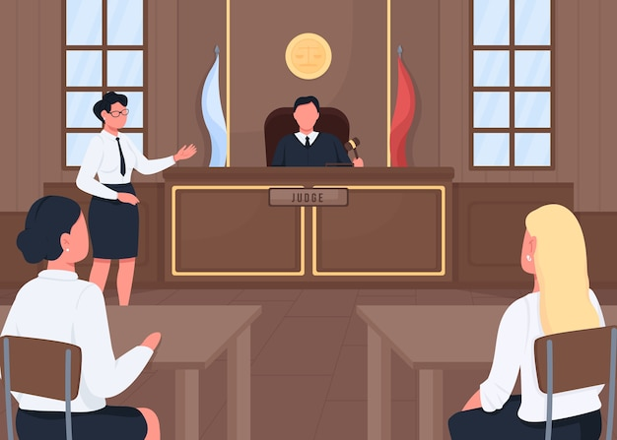
Volunteers In Court
Only crisis intervention volunteers may be in court with a client.
Additional Training
  Consists of accompanying/shadowing a staff member and client for a minimum of two court hearings.
Remember
  Advocates CANNOT participate in the proceedings. You are there only to provide emotional support to the client.
  Clients accompanied by Volunteers must be clients of Stand Up Placer.
  Scheduling accompaniments: Court volunteers are notified on a weekly basis of upcoming client hearings via email by our DV Team.
  Volunteers are representing Stand Up Placer and must abide by Stand Up Placer and court guidelines.

Slide 22
Volunteers In Court
Do not give legal advice.
Provide procedural information and peer counseling support.
There is no way of predicting what the Judge will order, do not make promises.
Client’s need to be aware of the court’s view on custody and visitation.
Restraining orders are a step towards increased safety and empowerment.

Slide 23
Next Steps & Continued Support

Slide 24
Next Steps & Continued Support
Hearing Preparation:
The restrained person must be served with TRO and a proof of service must be filed with the court before or on the court date.
The initial hearing will be set in approximately 2 weeks.
The burden of proof is then upon the protected person.
Witnesses should appear in court, so their statements are not considered “hear-say”.
Helpful Things To Let The Client Know:
Report all violations of the order. Law enforcement may be resistant so insist on reports.
Call the crisis line for support at any time and/or meet with an advocate during business hours.
Document all details of incident and LE’s response.
Keep a calendar and/or keep a journal.
Attend support groups.

Slide 25
Recantation Coercion

Slide 26
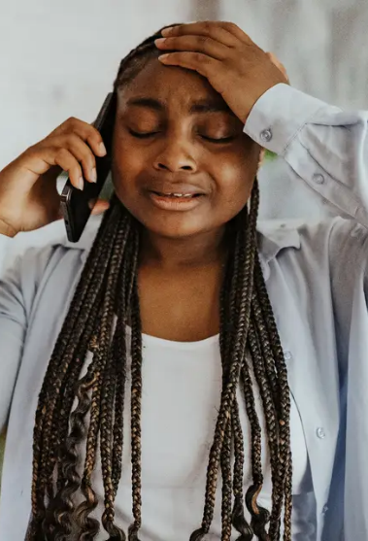
Recantation Coercion
Recantation is when someone takes back their statement or testimony regarding events that led to criminal charges of a perpetrator.
In domestic violence cases, survivors may recant for various reasons:
Fear of future abuse escalating
Promises of change from abuser and love for their partner
Financial dependence on abuser
Distrust of the criminal justice system
Fear of deportation
Complex caretaking needs with the abuser

Slide 27
Coercion Drives Recantation in Domestic Violence Cases
Dr. Amy Bonomi at San Diego State University, along with David Martin, Senior Deputy Prosecutor released their findings in 2023 after studying jail calls coming from abusers to their partners.
In their book Recantation and Domestic Violence: The Untold Story, they explain the pattern they uncovered that ultimately led many survivors to recant.
Studies found that in 80 percent of domestic violence cases that reach the court system, survivors have recanted or refused prosecution, often because of the manipulation of their abusive partners from behind bars.
Another alarming statistic – 100 percent of all of the cases studied by Bonomi and Martin where the survivors recanted, they had been previously strangled.
Tactics include: gaslighting, minimizing abuse, sympathy appeals and shared memories to erode independence and coerce compliance.
These strategies often occur even under no-contact orders.

Slide 28
