Slide 1


Agenda
Session Three
Trauma & Trauma Informed Care Defined
What Is A Crisis & Common Reactions
Keys of Crisis Intervention
Guiding Principles
Goal of Peer Counseling & Empowerment Wheel
Basics of Counseling Survivors
Honing Your Skill Set & Active Listening Techniques
Role Plays

Slide 2



Trauma Defined
Events or circumstances experienced by an individual as
physical or emotionally harmful or life-threatening which
result in adverse effects on the individual’s functioning
and well-being. Examples can include:
Physical, sexual and emotional abuse
Childhood neglect
Poverty and discrimination
Family members with a mental health disorder
Sudden separation from a loved one
Source: The Substance Abuse and Mental Health Services Administration (SAMHSA)

Slide 3


What Is Trauma? The author of “The Body Keeps the Score” explains | Bessel van der Kolk (8 min)

Slide 4
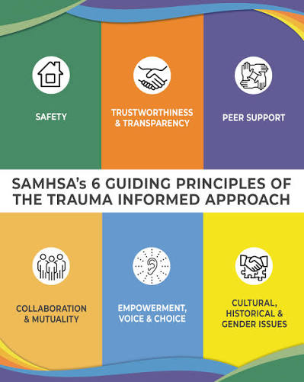
Core Components Of Trauma Informed Care
Late 1990’s – early 2000’s
Growing out of earlier work with Vietnam War veterans and recognition of PTSD in 1980.
Key principles: building trust, offering options, and creating collaborative partnerships to avoid re-traumatization and help survivors heal and build resilience.
Source: Substance Abuse and Mental Health Services Administration
Notes:
SAFETY – Phys/Emo TRUST: Reliability PEER SUPPORT: Advocates/support groups COLLAB/MUTUALITY - partnership between providers and survivors, valuing their input and decision-making.
EMPOWERMENT/VOICE/CHOICE – Recognizing and building on a person's strengths and resilience to promote their ability to recover and thrive. CULTURAL/HISTORICAL/GENDER – meeting where survivors are at

Slide 5

What Is A Crisis?
A dramatic emotional, physical or circumstantial upheaval in a person's life.

Slide 6
Common Reactions To Crisis:
Physical
emotional
Shock
Numbness
Fight, Flight, Freeze
Adrenaline
Change in heart rate
Hyperventilation
Body relieves itself
Things move in slow motion
Shock
Disbelief
Denial
Fear/Terror
Confusion
Frustration
Feeling out of control
Guilt
Grief
Loss of trust
Anger
Uncontrollable Crying
Feeling shut down
Lack of emotional reaction/s
Loss of faith
Feeling alone
Feelings of being a burden
Feeling crazy
Severity of reactions may depend upon:
Severity of the incident
Duration of the incident
Pre-existing trauma
Suddenness/unexpectedness of the incident
Abusive pattern is recognized or has escalated

Slide 7

Keys Of Crisis Intervention
To help survivors absorb what has occurred, to provide a space for them to talk about it, and assist them in deciding what they would like to do next.
An educational tool to help the survivor begin to resolve the immediate crisis and/or move in that direction.
To provide resources/referrals as indicated.
Immediate peer assistance; not psychotherapy.

Slide 8
Guiding Principles
Empowerment is the core of trauma informed advocacy.
Empowerment is a multi-dimensional, social process of increasing the capacity of individuals or groups to make choices and to transform those choices into desired actions and outcomes.
In the empowerment model, a person seeking help is assumed to be basically healthy and in need of understanding, concrete information, support and resources to make their desired changes.

Slide 9
Guiding Principles
Believe the survivor.
Often perpetrators rely on reality distortion (gas lighting) and victims fear not being believed. Convey only the abusive partner is responsible for the abuse.
Condemn the abuse, not the abuser.
If you attack the perpetrator, the survivor may feel the need to defend their abusive partner.
Inquire if they are safe and are able to talk.
If the situation warrants, express concerns for their safety.
Respect their right to self-determination and let them decide their own pace for change.
Offer options and support without attempting to talk them into a particular action. Do not take it personally if they do not take action or utilize your advice.

Slide 10
Guiding Principles
Know they do not need rescuing.
Help them assess their own resources and support system/s. Help them define the problem, not solve it.
The only things you know about their life is what they share with you.
Do not make assumptions.
Practice cultural humility and respect.
Listen and be aware of your own personal biases.
Understand the dynamics of domestic violence.
Keep in mind many survivors leave and go back to their relationships many times. Remember the cycle of violence.

Slide 11


Goals Of Peer Counseling
Validate
Validate their experiences
Advocate
Advocate for their safety
Explore
Explore their options
Build on
Build on their strengths
Respect
Respect their right to make their own decisions

Slide 12
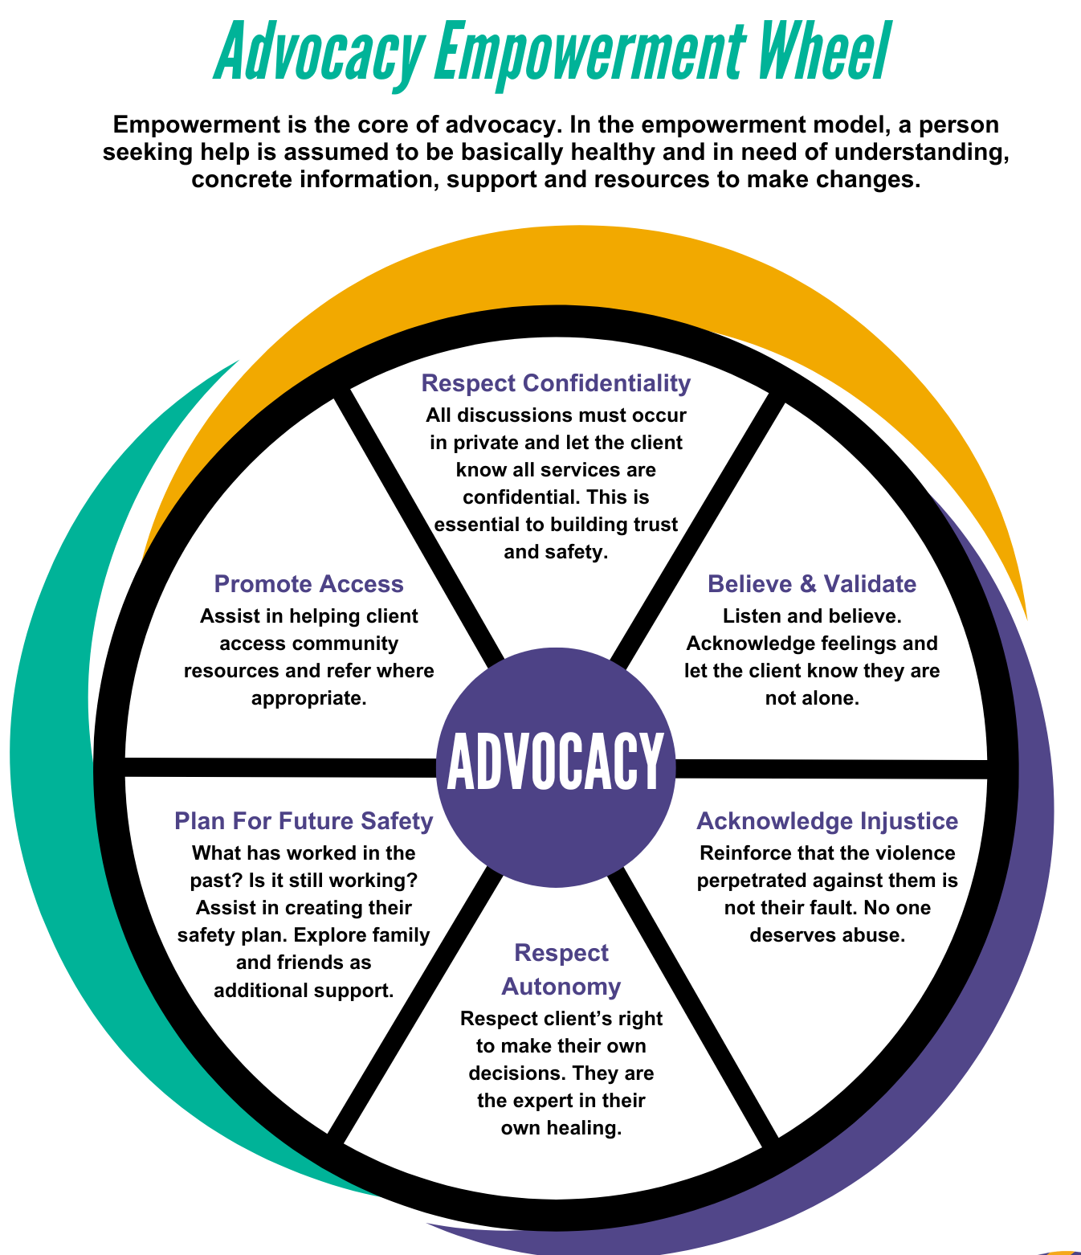
Advocacy Empowerment Wheel
Respect Confidentiality
  All discussions must occur in private unless otherwise requested by the client.
  Let the client know all services are confidential.
  This builds trust and helps ensure safety.
Believe & Validate
  Listen and believe.
  Acknowledge feelings and let the client know they are not alone.
Acknowledge Injustice
  Reinforce that the violence perpetrated against them is not their fault.
  No one deserves to be abused.
Respect Autonomy
  Respect the client’s right to make their own decisions.
  They are the expert in their own healing.
Plan For Future Safety
  What has worked in the past? Is it still working?
  Assist in creating their safety plan.
  Explore family and friends as additional support.
Promote Access
  Assist in helping client access community resources and refer where appropriate.

Slide 13

The Basics Of Counseling Survivors
Breathe and center.
Speak clearly and slowly.
Listen.
Take notes if needed.
Fear is contagious. Remain calm.
Let the client tell their story at their own pace.

Slide 14
The Basics Of Counseling Survivors
Find YOUR style.
No two advocates are the same!
You will find your groove quicker than you think.
Bottom line: Be yourself and have a working understanding of agency and local resources.
The following active listening skills are suggestions.
Use only what feels right for you and the client you are helping.

Slide 15
Active Listening Techniques
Allow Silences
Take your time…I am here. It’s OK not to talk.
Provide Acknowledgements
Uh, huh. Oh. Mmmm… Go on.
Door Openers
Can you tell me more about it? Sounds like you have some feelings about this…would you like to say more?
Clarifying
Helps you connect with the client by making sure you understand what they are saying. I heard you say you feel overwhelmed and lost. Is that correct?
Reflection of Feelings
Confirms your understanding of the feelings shared. Client: I can’t tell my husband about this…he’ll say I asked for it. Advocate: It sounds like you are afraid your husband will blame you for the rape?
Summarizing
Can be very helpful especially with highly emotional clients. Ok, let’s slow down…lets take a breath together. You are afraid he will come back and do not want to file a police report but you would like a restraining order.

Slide 16
Honing Your Skill Set
Communication Blockers
Give Solutions or Advice
Why don’t you try… You should…
Evaluate
Analyze
It ‘s clear you cannot admit this to yourself…
Instruct Or
Lecture
Just think what it must be like for your children.
Asking Too Many Yes/No/Why (Close-ended Questions) or Interrogate
Why do you stay? Have you ever called the police? Do you need shelter? Were the children there when he hit you?
Quick Reassurance - causes alienation.
You don’t need to worry about that… I have heard way worse, so you shouldn’t worry about that!

Slide 17
Honing Your Skill Set
Encourage with open ended questions.
Can you tell me a little about your situation?
What’s happening right now for you?
What is your biggest concern?
How do you feel?
Clarify and check-in.
I’m not sure I understand. Did you say…?
Affirm.
I’m really glad you called today.
That must have been a difficult decision to make. Good for you!
Paraphrase/Summarize.
What I am hearing is that you are in fear of your partner; don’t see a way out and still love her. Is that correct?
Use Empathic Response Leads.
  If I’m hearing you correctly… It seems you… What I hear you saying is… As I listen to you, it seems as if you may be feeling… Can you please tell me more?

Slide 18
Honing Your Skill Set
Identify Emotions – putting feelings into words can be empowering.
Sounds like you are feeling really angry and at the end of your rope.
I can hear the pain and despair in your voice.
Validate.
It’s OK to cry…take your time, I am here.
You have a right to be angry and I honor your courage.
Restate – allows for a conversation pause.
So far I heard you say…. Is that correct? Ok, good. Tell me more.
Identify & Explore Values – without judgement.
It sounds like divorce is not an option for you. Let’s talk about other options and how you can stay
safer.

Slide 19
Honing Your Skill Set
Reframe.
Client: I am just so stupid for staying with him!
It’s not stupid to want things to work out and have things be better in your relationship. You gave yourself time to do what you needed to do. I think that makes you very strong.
Normalize – educating them on common dynamics of violent relationships can be empowering and they may feel less isolated.
A lot of people have experienced that kind of cycle. The fights and the making up is really common.
No one deserves to be treated that way. It’s not surprising you feel sad and angry.
Identify & Inform Client About Options
For example, talk about agency services, police reporting, restraining orders, etc.
Check In
I know we talked about a lot and I gave you all kinds of information. This can be overwhelming and that is OK. Do you have any questions for me? How are you doing?

Slide 20

Be Impeccable With Your Word
Speak with integrity. Say only what you mean. Avoid using the word to speak against yourself or to gossip about others. Use the power of your word in the direction of love and truth.
Don’t Take Things Personally
Nothing others do is because of you. What others say and do is a projection of their own reality, their own dream. When you are immune to the opinions and actions of others, you won’t be the victim of needles suffering.
Don’t Make Assumptions
Find the courage to ask questions and to express what you really want. Communicate with others as clearly as you can to avoid misunderstandings, sadness, and drama. With just this one agreement, you can completely transform your life.
Always Do Your Best
Your best is going to change from moment to moment; it will be different when you are healthy as opposed to sick. Under any circumstance, simply do your best, and you will avoid self-judgement, self-abuse and regret.
Notes:
The book, The Four Agreements: A Practical Guide To Personal Freedom (1997) was written by Mexican author and Toltec Wisdom teacher, Don Miguel Ruiz. The Four Agreements can be helpful reminders to staying grounded in peer counseling and advocacy work.

Slide 21

Dr. Brene’ Brown on Empathy vs Sympathy (3 min)

Slide 22
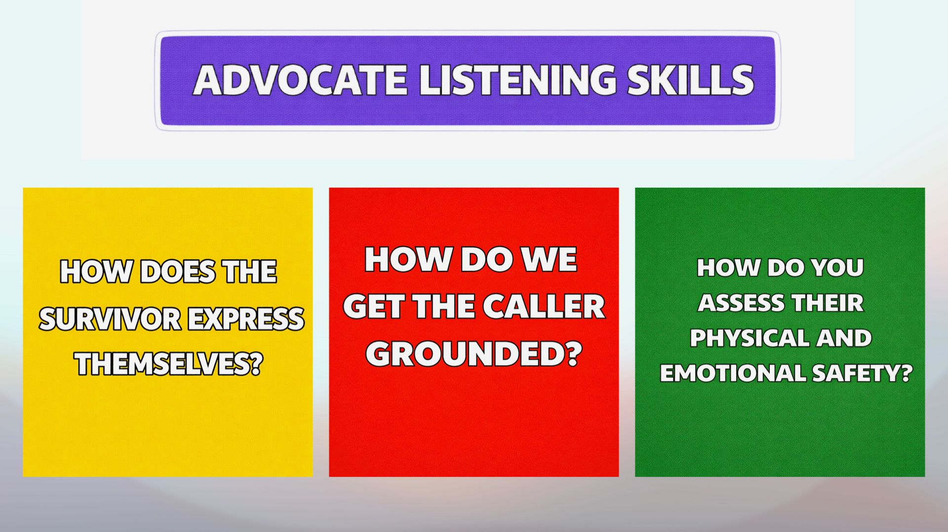

Slide 23
